Slide 1
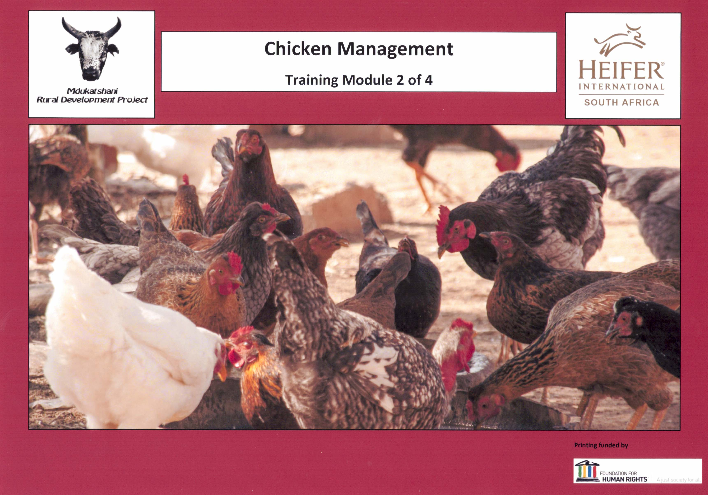
Cover page

Slide 2
Contents

Slide 3
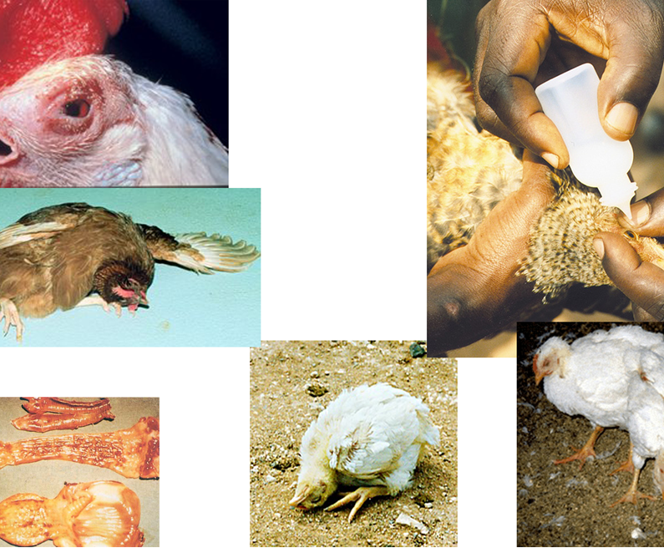
1. Newcastle disease
Notes:
Newcastle-page 17
Do we see it in this area?
Males or females—old or young?
At what time of the year?
What are the symptoms?
What are some local treatments?
What causes it?
How is it spread?
How can it be prevented?
How can it be treated?

Slide 4
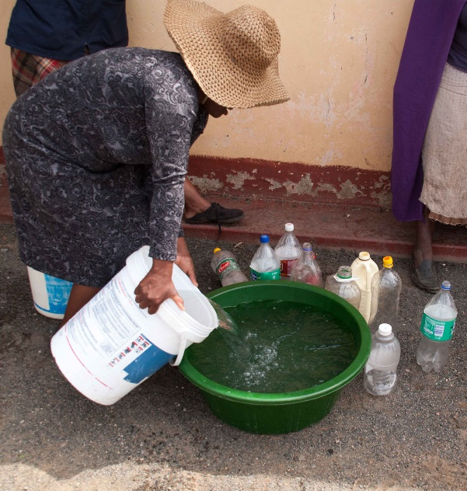
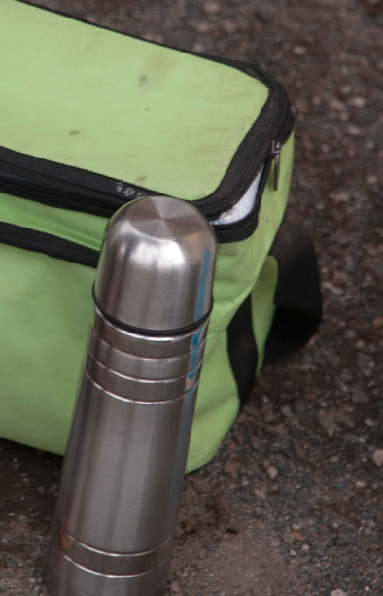
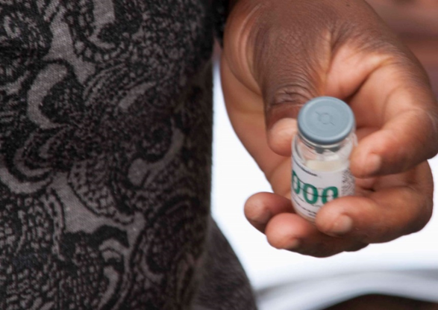
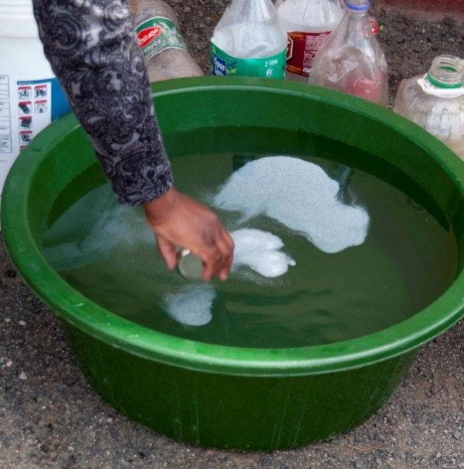
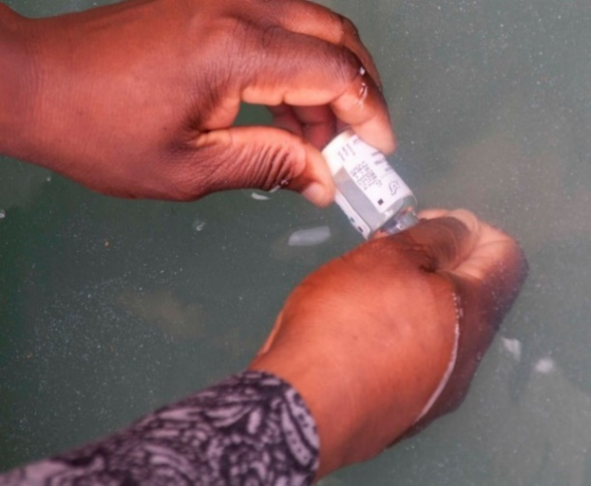
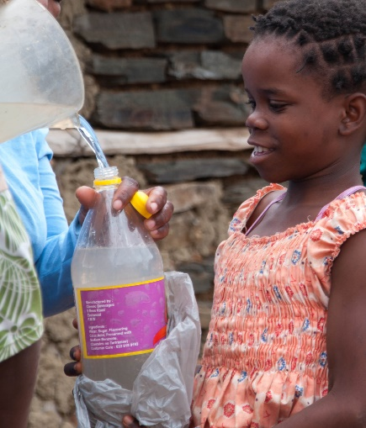
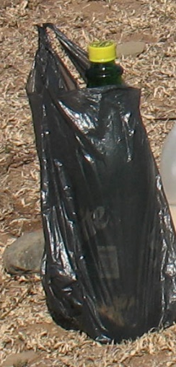
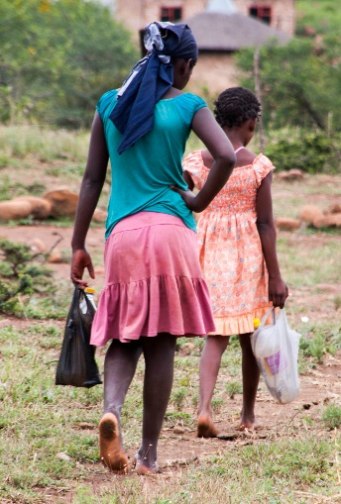
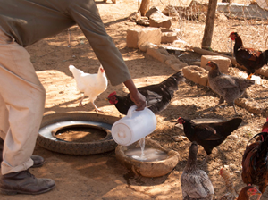
2. Newcastle vaccination guide
Notes:
Newcastle Step by step- page 18
Where is the water coming from and why does this matter?
What is being poured into the water before the vaccine?
Why is the bottle covered with a plastic bag?
How many hours after mixing is the vaccine useless?
What containers should the vaccine not be poured into?

Slide 5
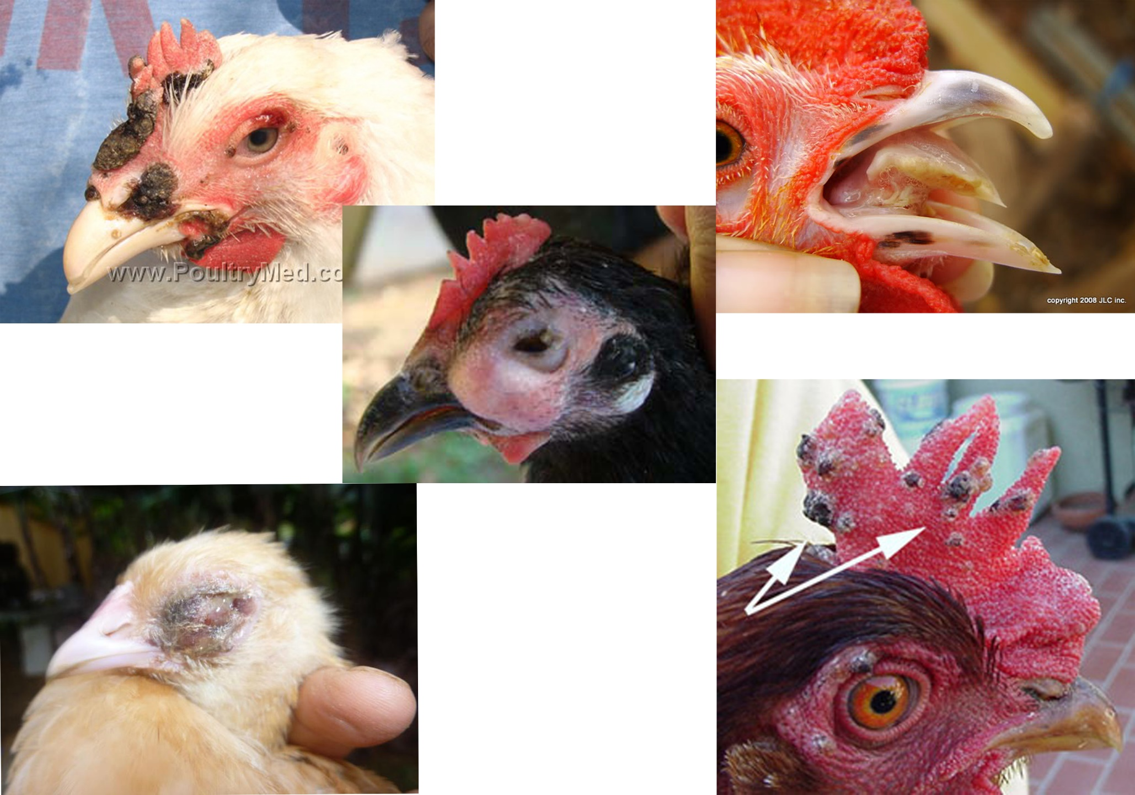
3. Fowlpox
Notes:
Fowlpox-page 22
Do we see it in this area?
Males or females—old or young?
At what time of the year?
What are the symptoms?
How is fowlpox spread from one bird to another?
What are some local treatments?
What causes it?
How can it be prevented?
How can it be treated?

Slide 6
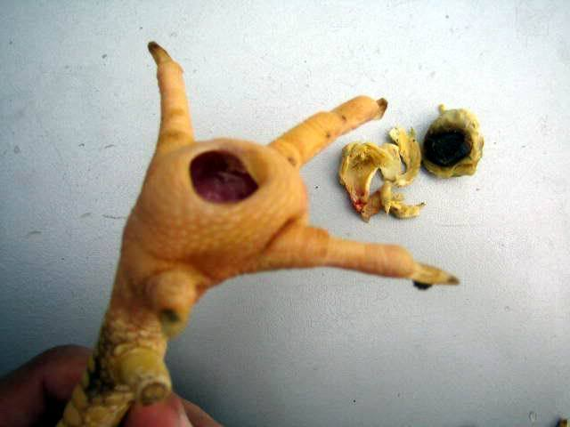
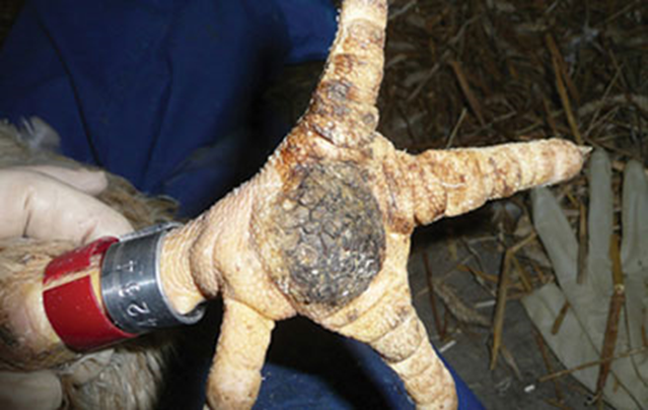
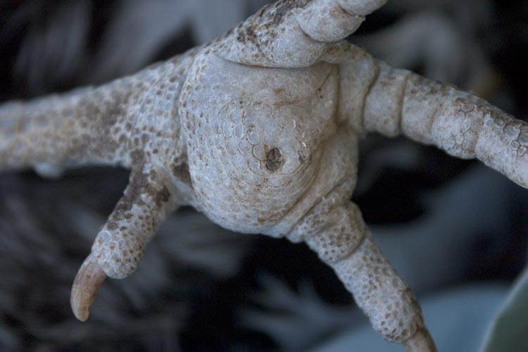
4. Bumblefoot
Notes:
Bumblefoot- page 23
Do we see it in this area?
Males or females—old or young?
At what time of the year?
What are the symptoms?
What are some local treatments?
What causes it?
Is it contagious from one bird to another?
How can it be prevented?
How can it be treated?

Slide 7
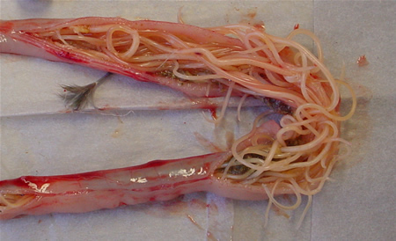
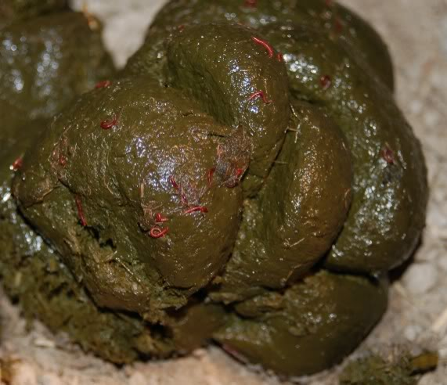
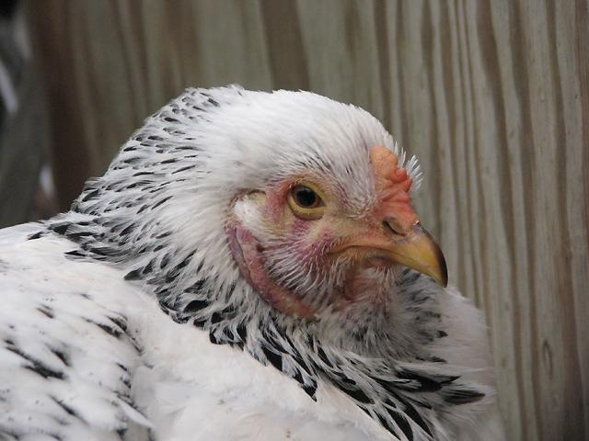
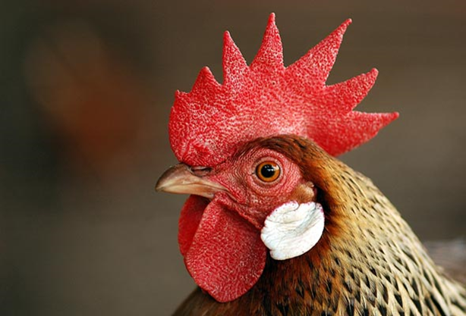
5. Worms
Notes:
Worms- page 27
Do we see it in this area?
Males or females—old or young?
At what time of the year?
What are the symptoms?
What are some local treatments?
What causes it?
How can it be prevented?
How can it be treated?
How are worms spread?

Slide 8
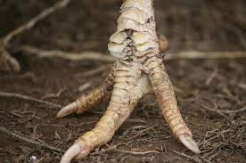
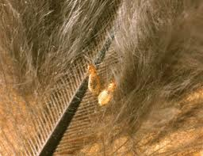
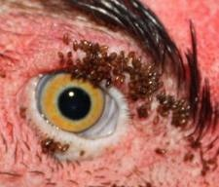
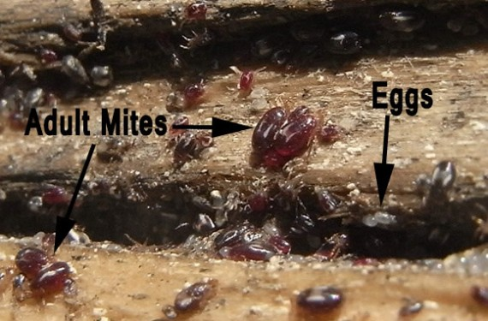
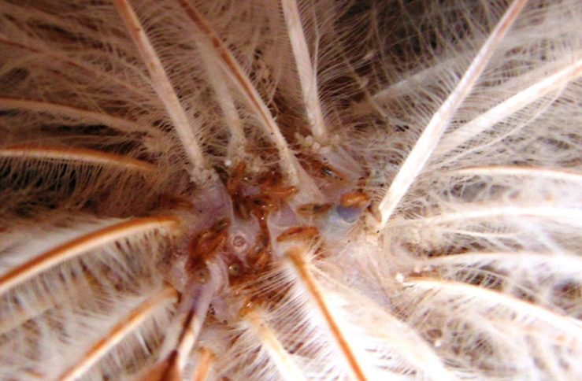
6. External parasites
Notes:
External parasites- page 25
What is an external parasite?
What are different types of external parasites?
Which of these conditions or parasites do you recognise?
Males or females—old or young?
At what time of the year?
What are the symptoms?
What are some local treatments?
What causes external parasites?
What can be used to control them?
What can you do to manage them?
What can you do once you have an infestation?

Slide 9
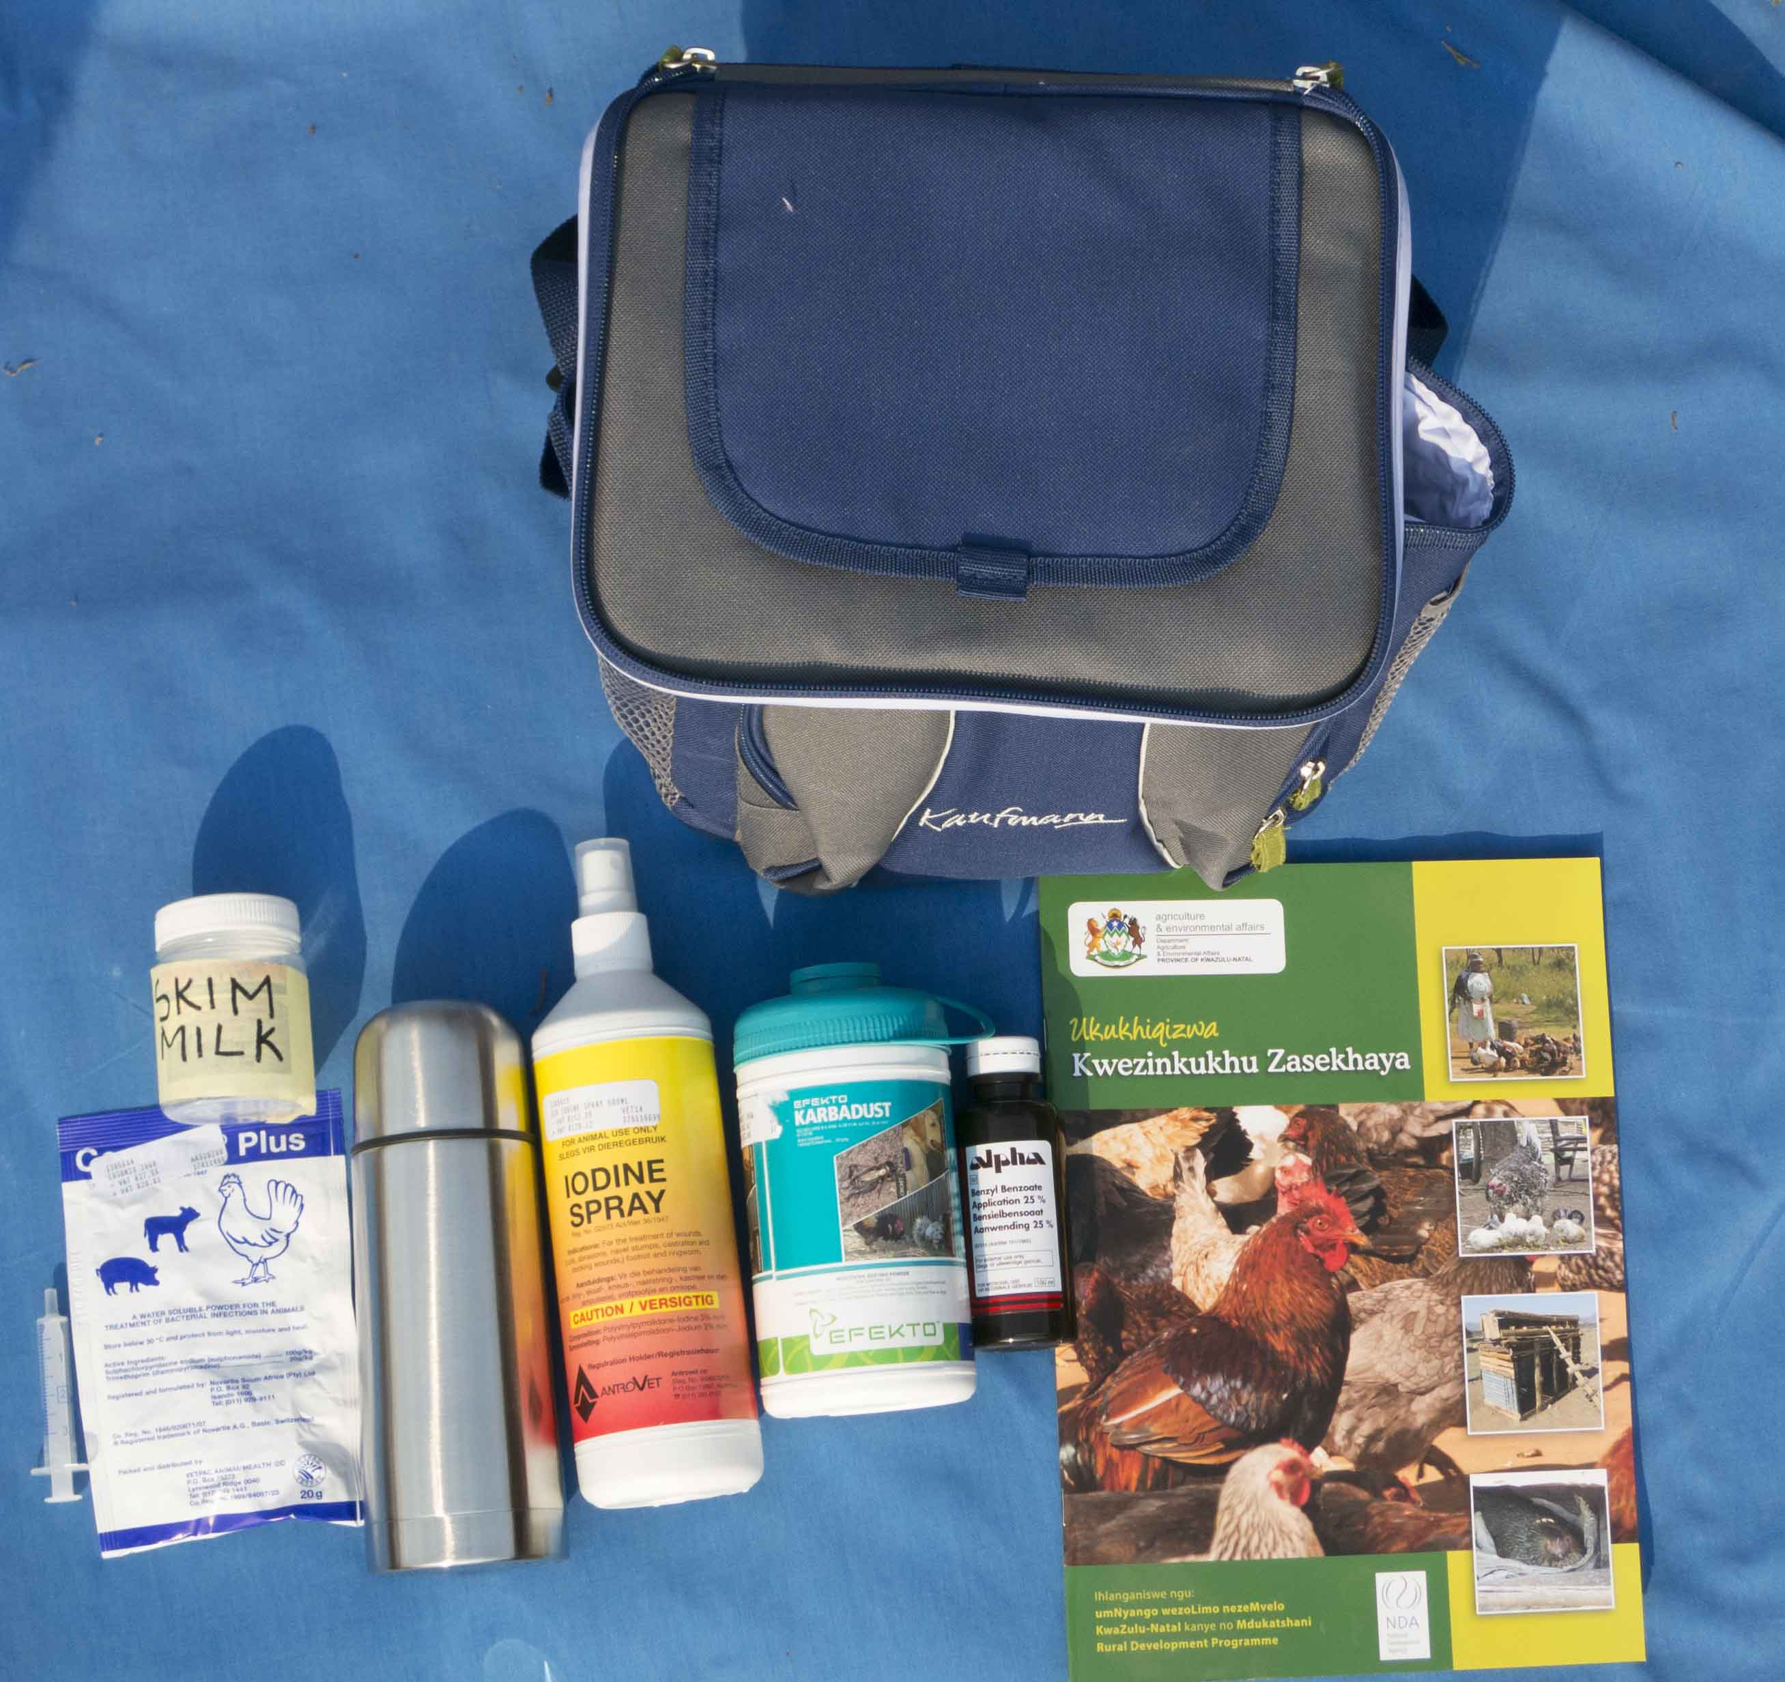
7. Chicken vet kit
Notes:
Chicken vet kit- page 9
Name each item in this picture and its use?
What item is not in this picture?
Where do you get these items?
How do you store these products?

Slide 10
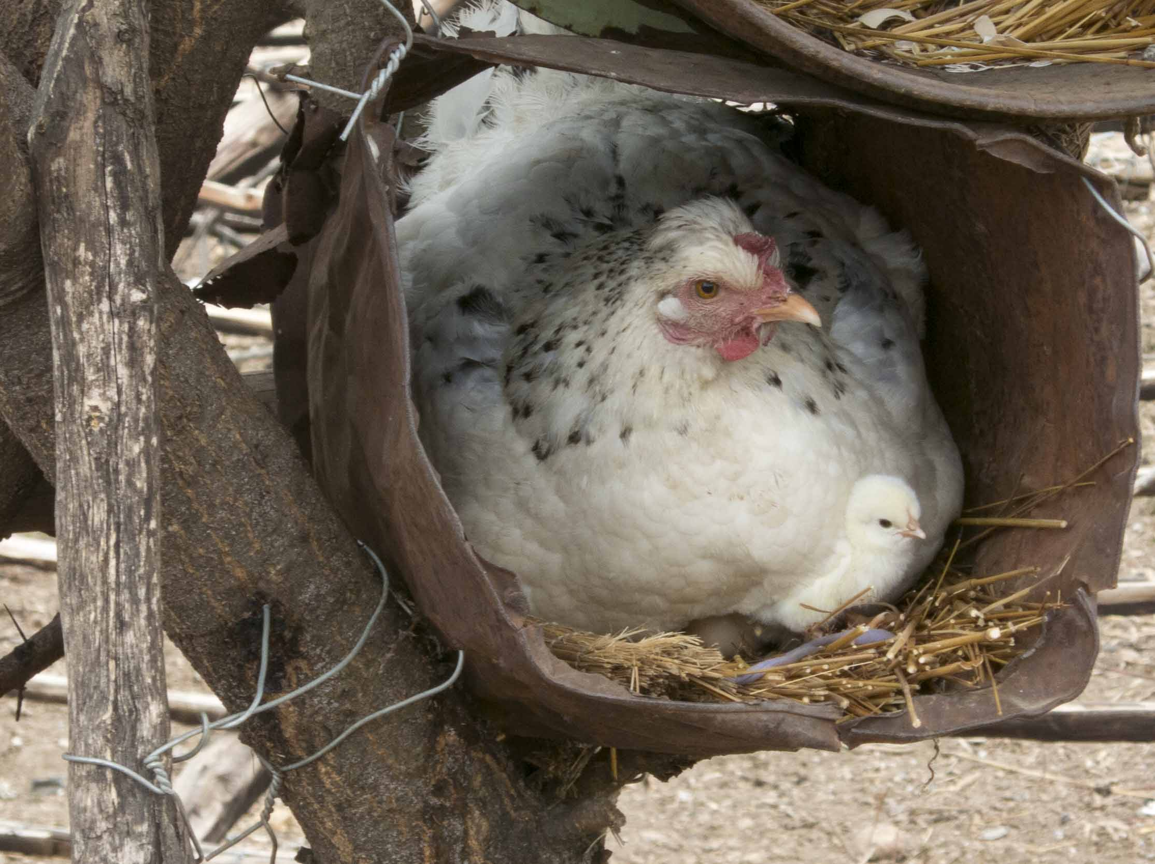
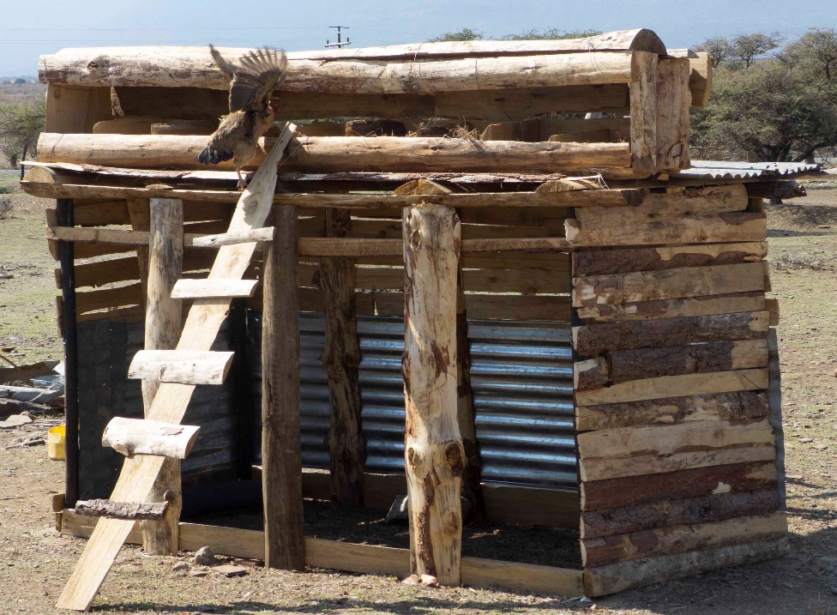
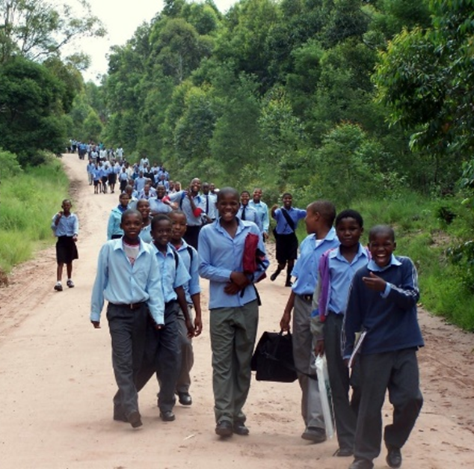
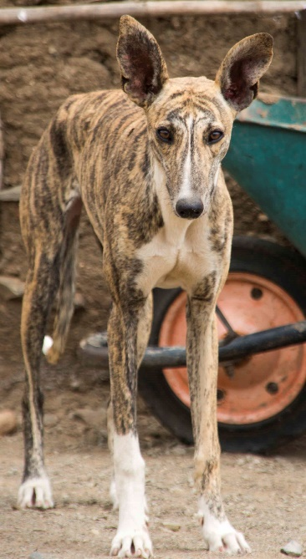
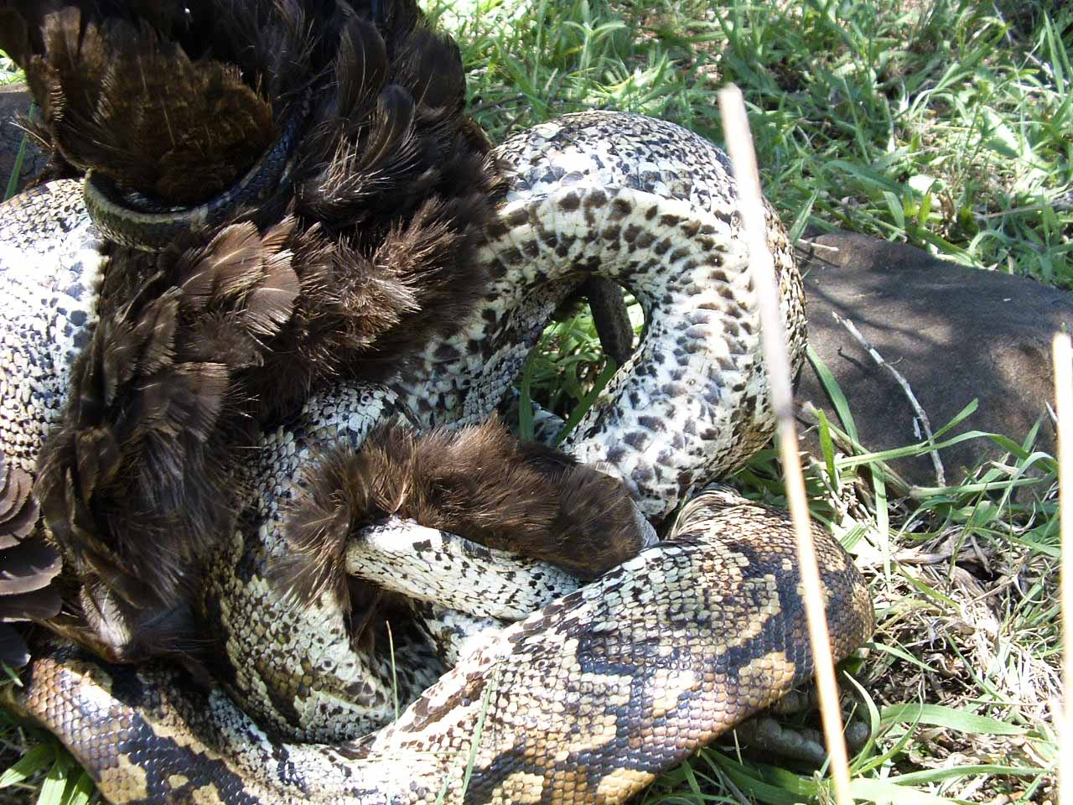
8. Management and protection
Notes:
Management and protection- page 8
Which of these are the biggest informal consumers of chickens and eggs?
What can be done about this?
What unique solutions do you have that are from this area?

Slide 11
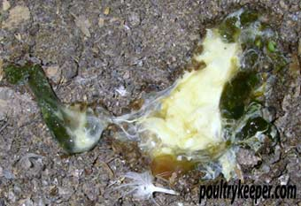
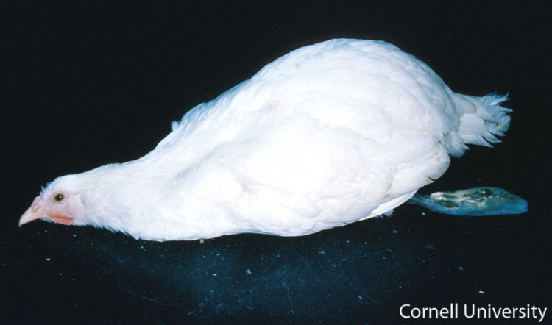
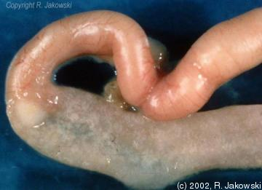
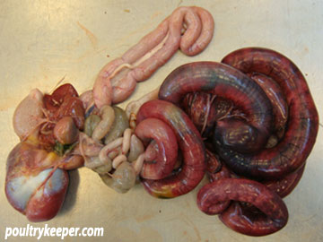
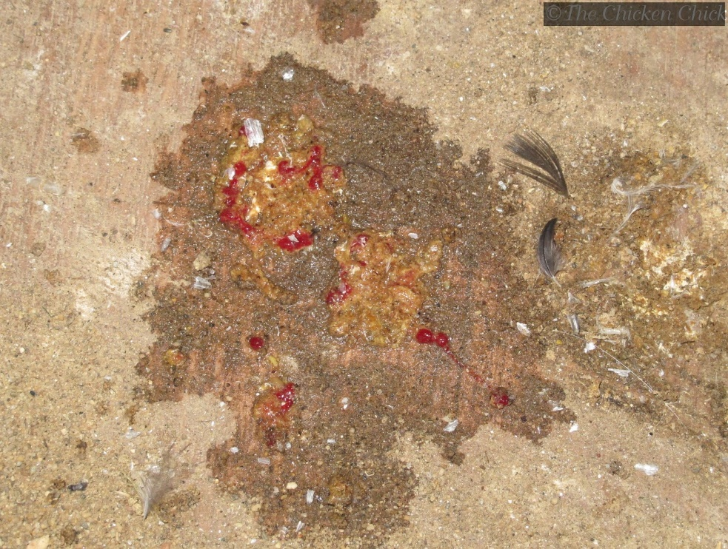
9. Diarrhoea
Notes:
Diarrhoea- page 24
Do we see it in this area?
Males or females—old or young?
At what time of the year?
What are the symptoms?
What are some local treatments?
What causes it?
How can it be prevented?
How can it be treated?

Slide 12
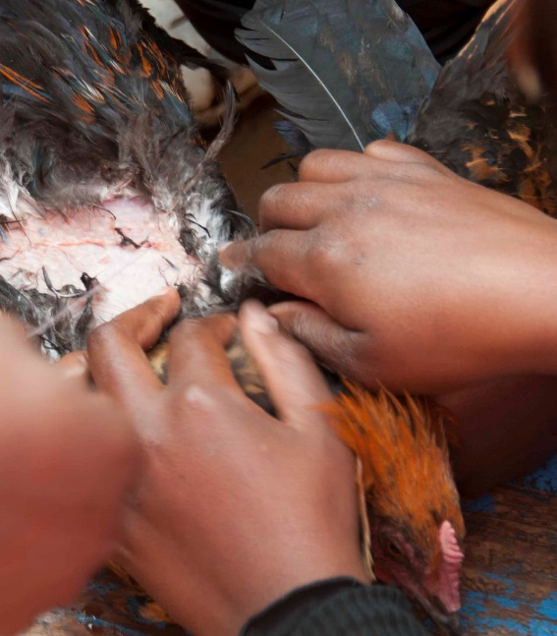
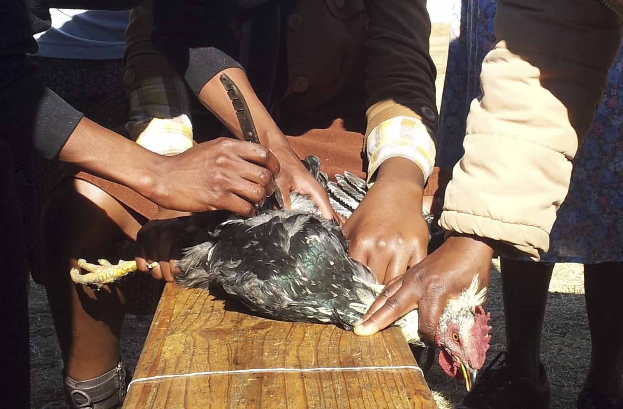
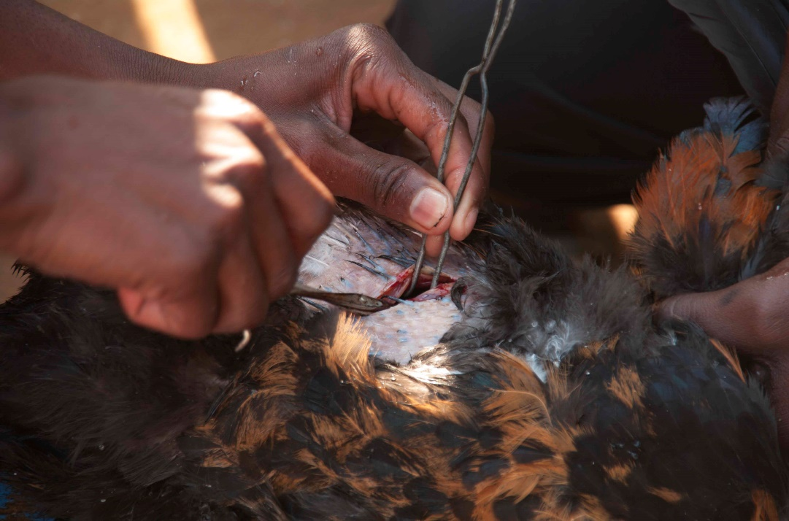
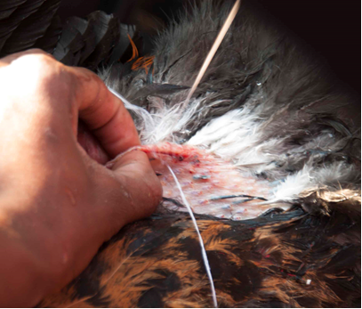
10. Castrating
Notes:
Castrating
Why would a farmer need to castrate?
What would the benefits of a castrated cock be?
What indigenous knowledge do you have of this?

Slide 13
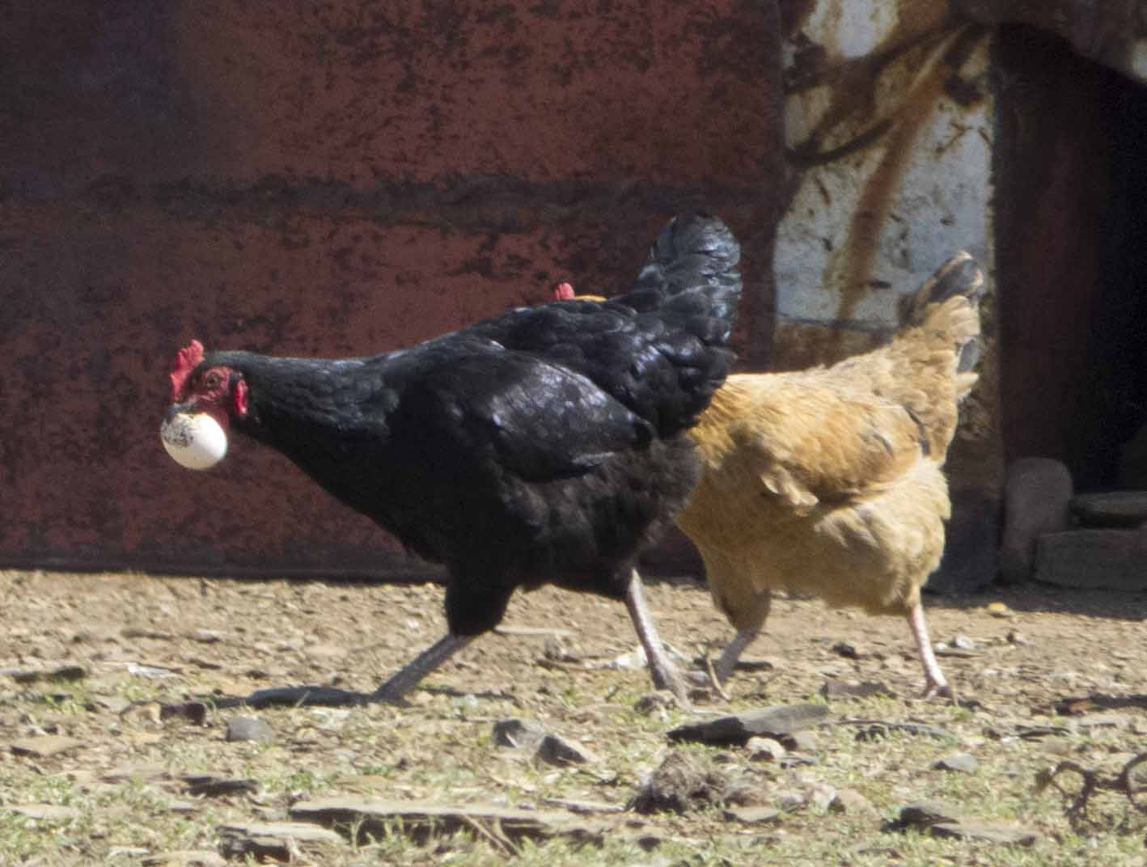
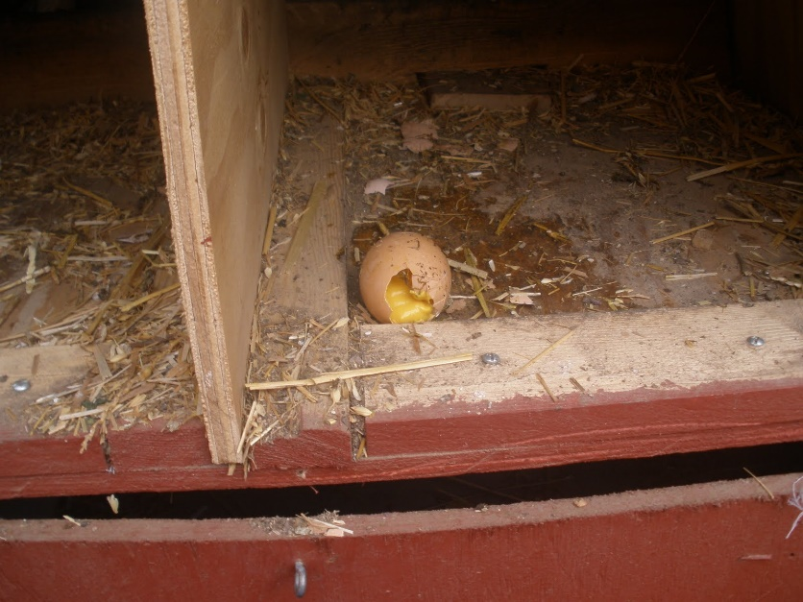
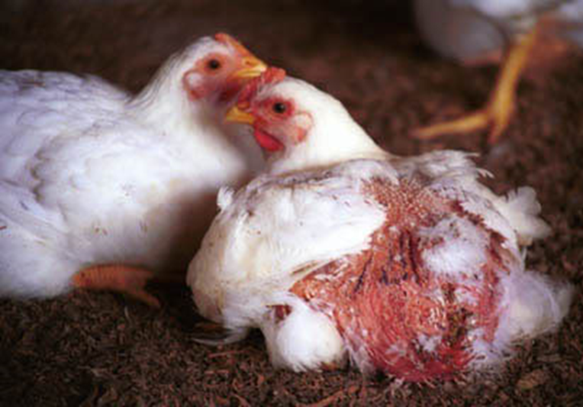
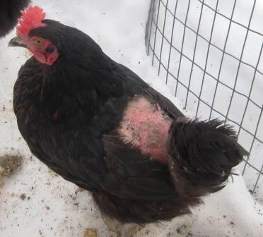
11. Nutrition and eating disorders
Notes:
Nutrition and eating disorders- page 14
Have you seen this behaviour in your chickens?
Why do you think they are doing it?
What can you do to mitigate or stop it?
What is a better management system to prevent it?

Slide 14
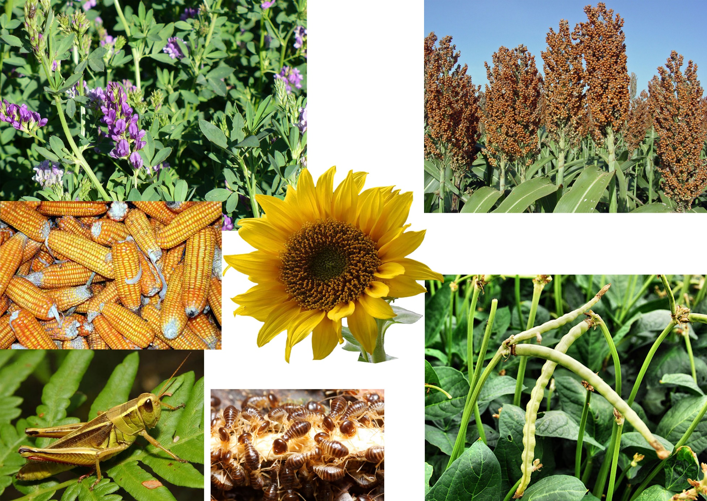
12. Nutrition
Notes:
Nutrition
Which of these items that chickens eat do you recognise?
Which are your chickens not getting?
How do you think this is effecting them?
What ways can you replace or supplement these missing food groups?

Slide 15
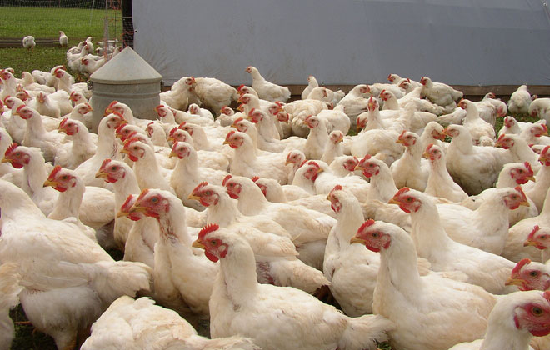
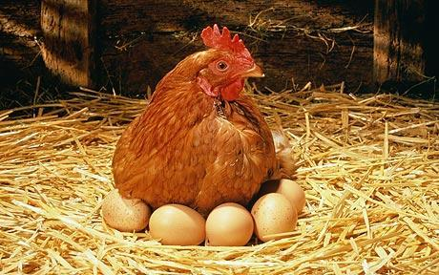
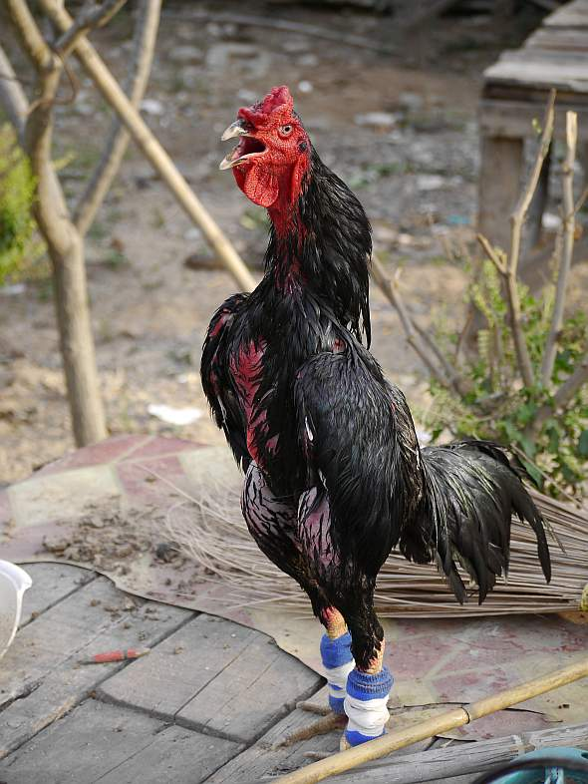
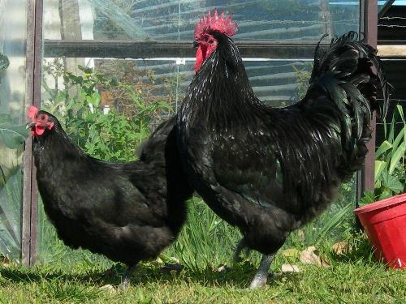
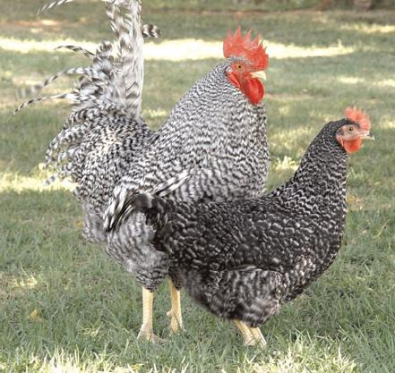
13. Breeds pros and cons
Notes:
Breeds pros and cons- page 4
Which of these breeds have you seen?
What do you think they were bred for?
What do you think there strengths are?
What possible problems could be introduced by outside breeds?

