Slide 1
Cover

Slide 2
Contents

Slide 3
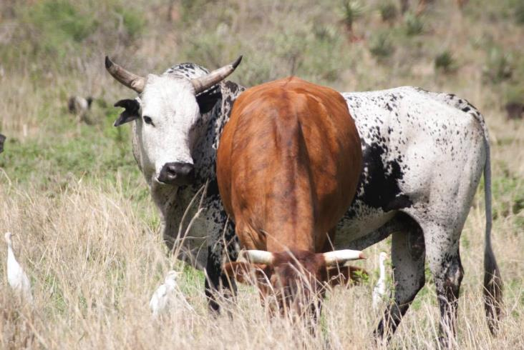
1. A Healthy Animal
Notes:
How to tell if my animals are healthy- page 8
It eats food in normal quantities and chews its cud
It moves with the flock or herd of animals
It breathes easily and doesn’t pant
It does not limp or bend its back while it’s standing or walking
It doesn’t have missing hair or feathers
It has nose that is slightly damp for cattle and dry for goats
It has eyes and nostrils that are not runny or have excessive mucous
It has eyes that are shiny and clear
It has mucous membranes that are pink and not white
It has dung and urine that are a normal colour and it is urinating/defecating normally

Slide 4
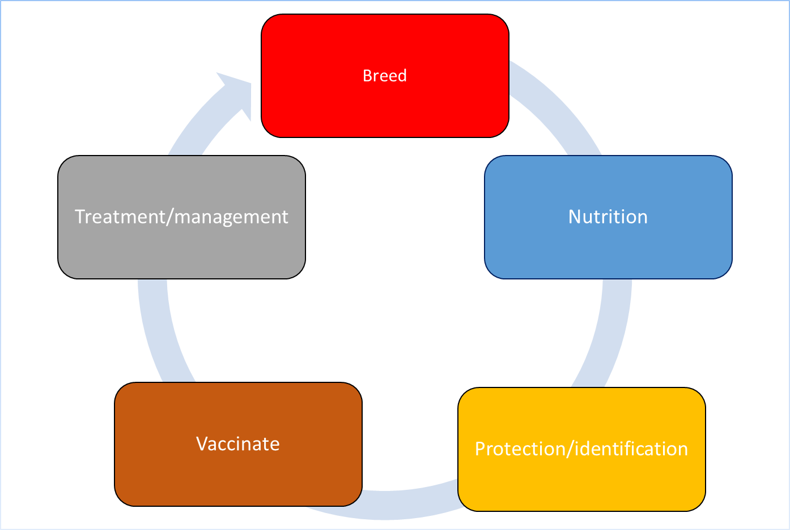
2. Basic principles of keeping animals
Notes:
Basic principles of keeping animals
Describe two things that are important about each of these principles of keeping animals.

Slide 5
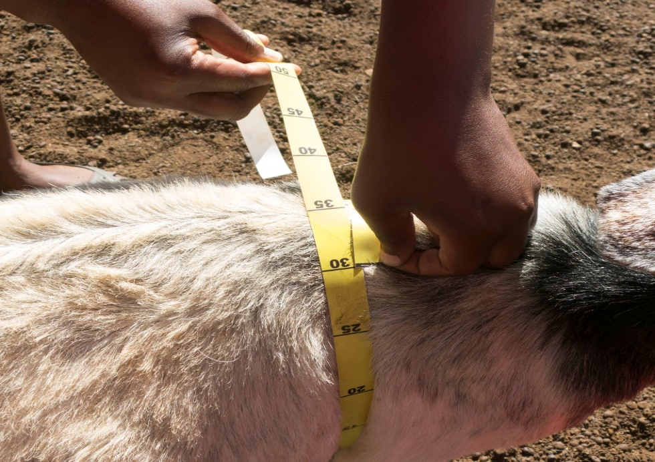
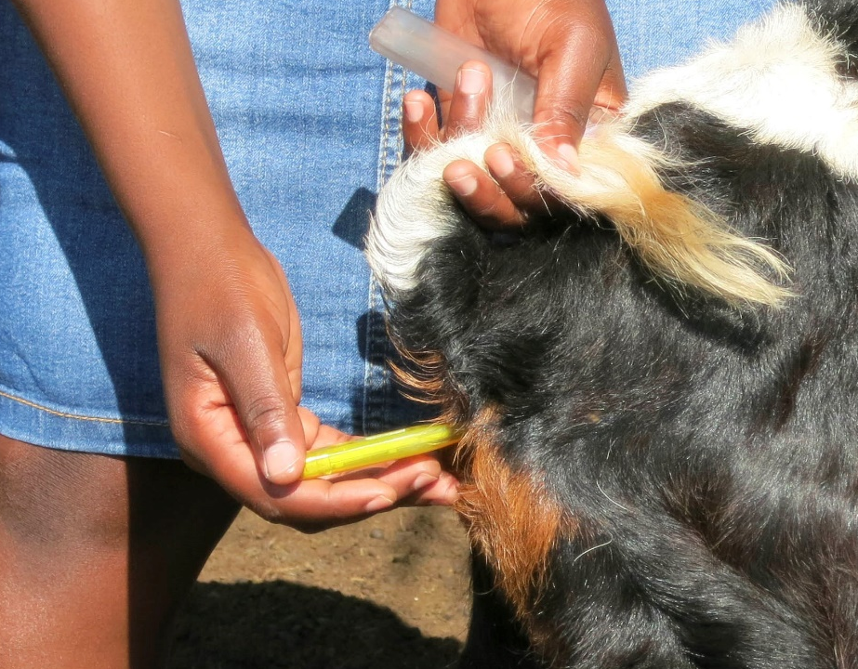
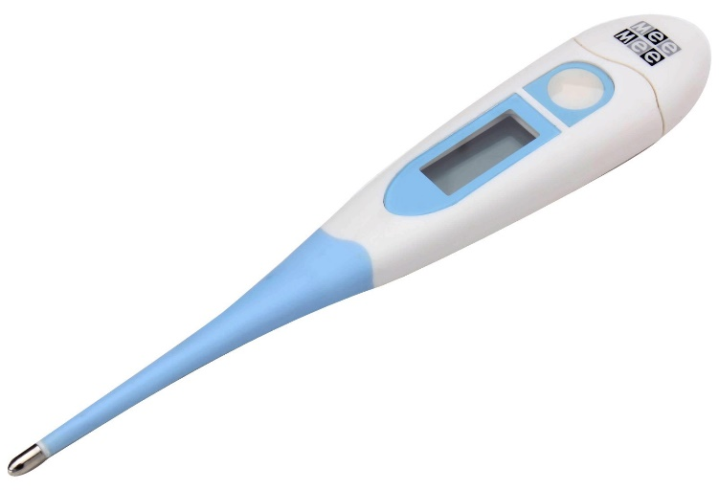
3. Taking temperature and girth belt
Temperature Guide
Range
? | 38 | 39
? | 39 | 40
? | 41 | 43
? | 38 | 40
Notes:
Temperature page 21
Why is temperature important?
What are the important things to consider before you take the temperature?
What is the best way to take an animal’s temperature in the field?
What are the temperatures per animal type?
If the animal has an abnormal temperature, what does this mean?
Girth belt page 24
What different girth belts are there?
Are there different girth belts for commercial and indigenous breeds?
What are the mistakes you can make in the field with a girth belt?
Why is it important to know the weight of your animal?
Describe the steps involved in weighing an animal.
Temperature Guide
Range
Cattle 38 39
Goats 39 40
Chickens 41 43
Sheep 38 40

Slide 6
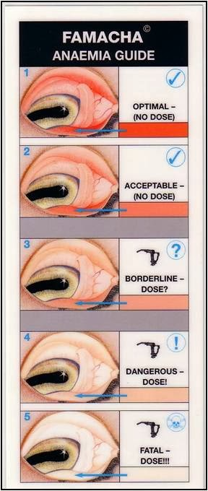
4. Anemia and 5 point check
Notes:
Famacha test page 22
Why is Famacha important?
What is it used for?
What type of worms can you detect?
What is the correct way to expose the inner membrane?
Famacha is used for what animals?
5 point check
Why is it important to do the 5 point check?
What are the 5 points to check?
What types of internal parasites can each point detect?
What other conditions can a dirty tail or low condition detect?

Slide 7
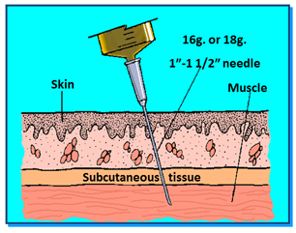
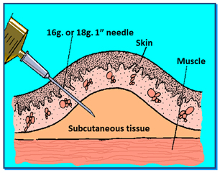
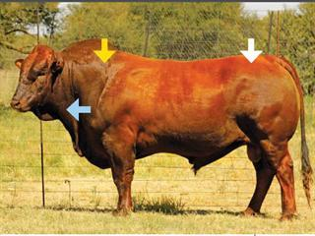
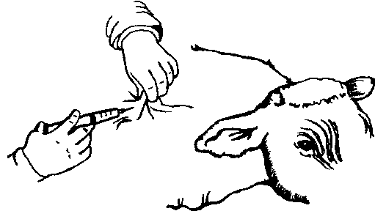
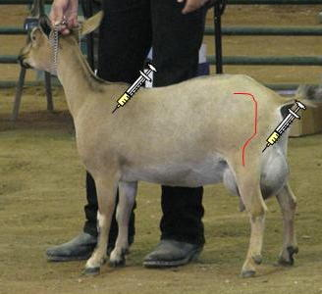
5. Injecting intramuscular/subcutaneous
Notes:
Injecting intramuscular/subcutaneous
Intramuscular- page 25
When do you give an intramuscular injection?
Where do you give an intramuscular injection?
What happens if you inject large amounts of medicine into one spot?
What if blood starts filling up the syringe when you inject?
Are there other dangers to watch for?
What do you do to the injection site after injecting?
Subcutaneous- page 26
When do you give an intramuscular injection?
Where do you give an intramuscular injection?
What happens if you inject large amounts of medicine into one spot?
What if blood starts filling up the syringe when you inject?
Are there other dangers to watch for?
What do you do to the injection site after injecting?

Slide 8
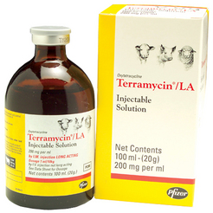
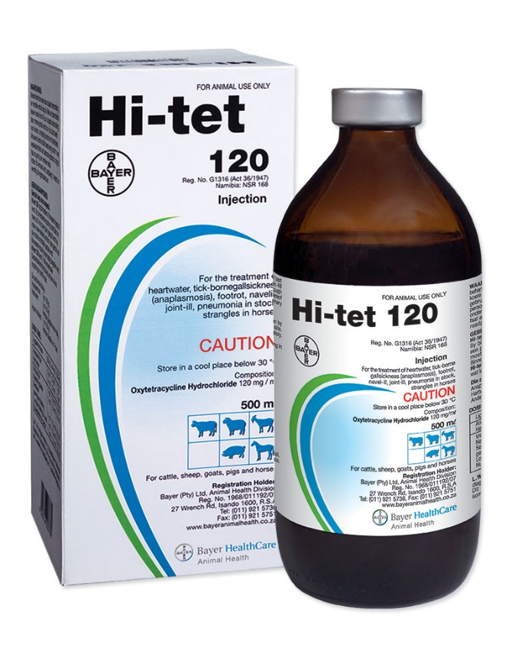
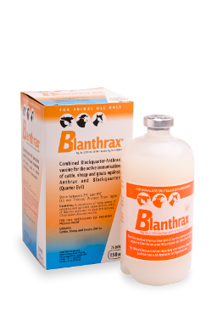
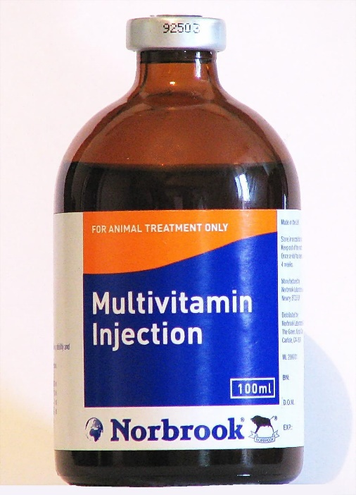
6. Injectables
Notes:
Which of these do you recognise?
What are the different purposes of these products?
Which of these would you use for what conditions?
What is the difference between short acting and long acting?
Which of these can you vaccinate with?

Slide 9
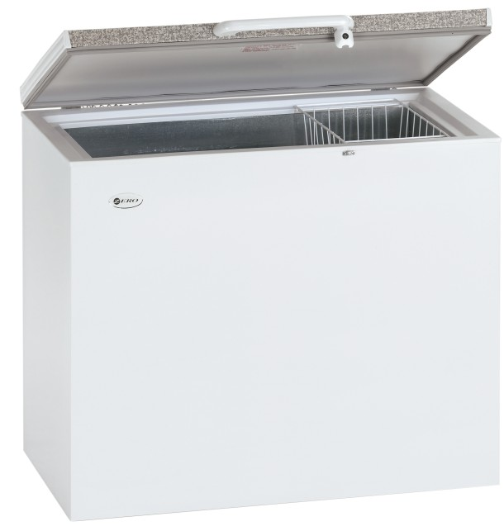
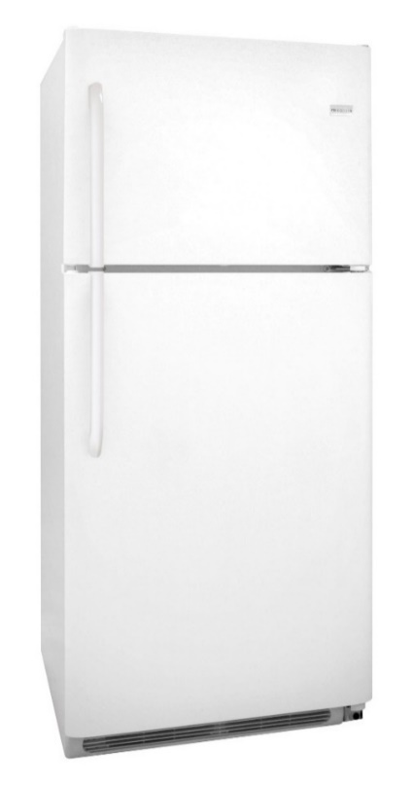
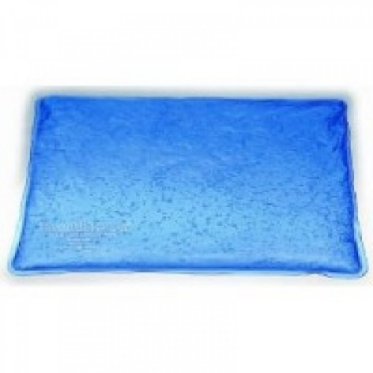
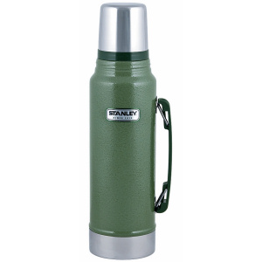
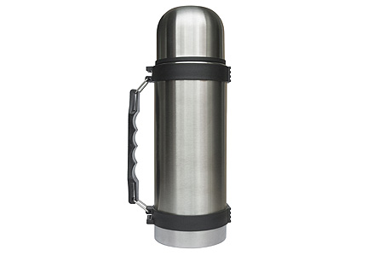
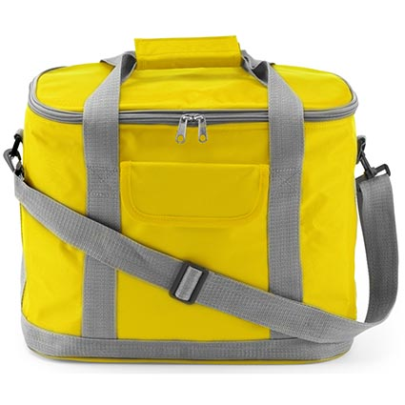
7. Cold chains
Notes:
Cold chains
Fridge and freezer
Which of these do you recognise?
What is the difference between these two types of fridges?
Which do you not use for vaccines?
What temperature does ice form?
What temperatures do vaccines have to be kept at?
Where’s the warmest and coldest part of a fridge?
Flask and cooler box
What can you carry in each of these – medicine or vaccines?
How long do each of these retain temperature

Slide 10
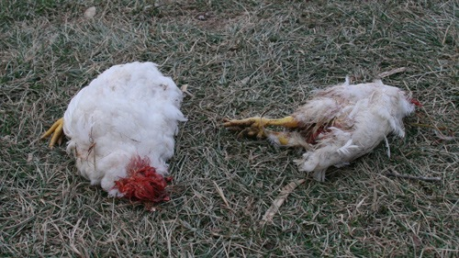
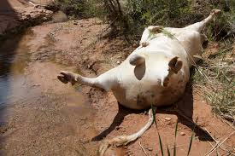
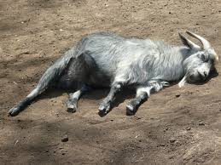
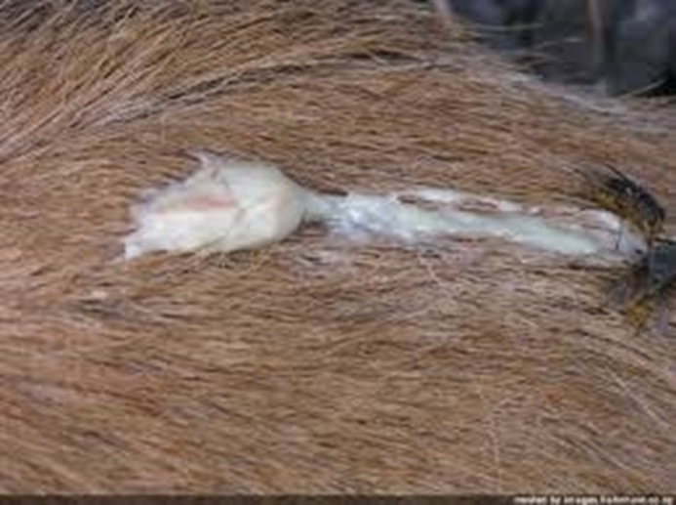
8. Disposal of dead animals
Notes:
Disposal of dead animals
What do you do with dead animals?
Are there better ways of disposing animals if you know that they carry diseases that can be passed on?
How do you make neighbours responsible for properly disposing of their own dead animals?

Slide 11
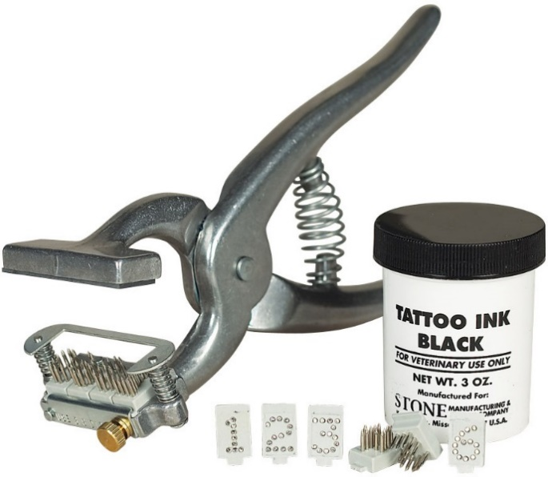
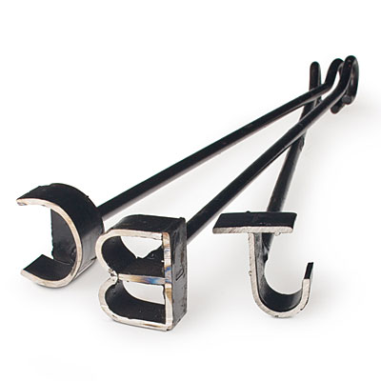
9. Livestock identification
Notes:
Livestock Identification
What do you need to do to have an animal identification certificate?
What are the implications of not having a state approved identification mark?
Does your dip tank have a mark and how would you use this?
Goat and sheep tattooing
Do you have a tattoo certificate?
Are all the symbols on your mark standard?
Where do you order your symbols?
Where do you put a tattoo?
Step by step discussion of tattooing process
Cattle branding
Note the branding iron needs to be made to a design that doesn’t
transfer heat too broadly and leave indecipherable mark
Where do you put a branding mark?
When is the best time to do branding?

Slide 12
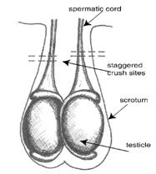
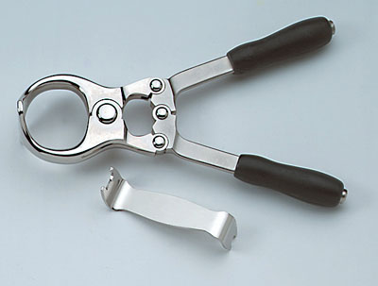
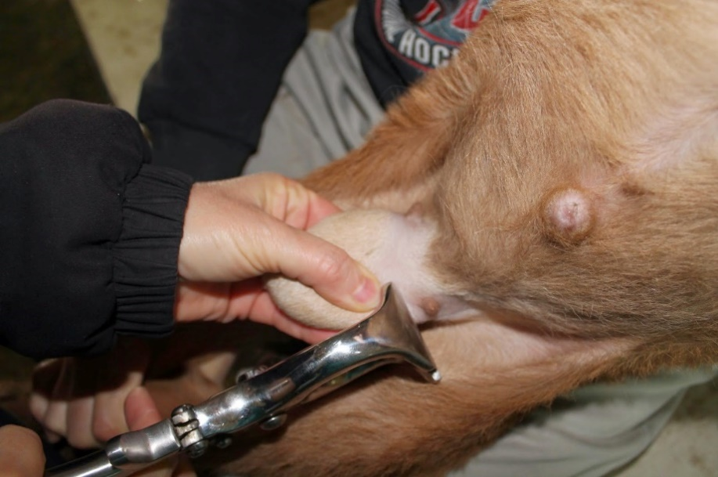
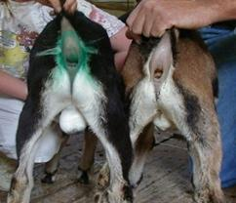
10. Castration
Notes:
Castration
Why is it important to castrate?
How do you decide which ones to castrate?
What is the differences do you expect to see between goats you have and haven’t castrated?
How long should you monitor your animal after castrating?
How will you know the castration was successful?
At what age is it best to castrate?
Step by step instructions

Slide 13
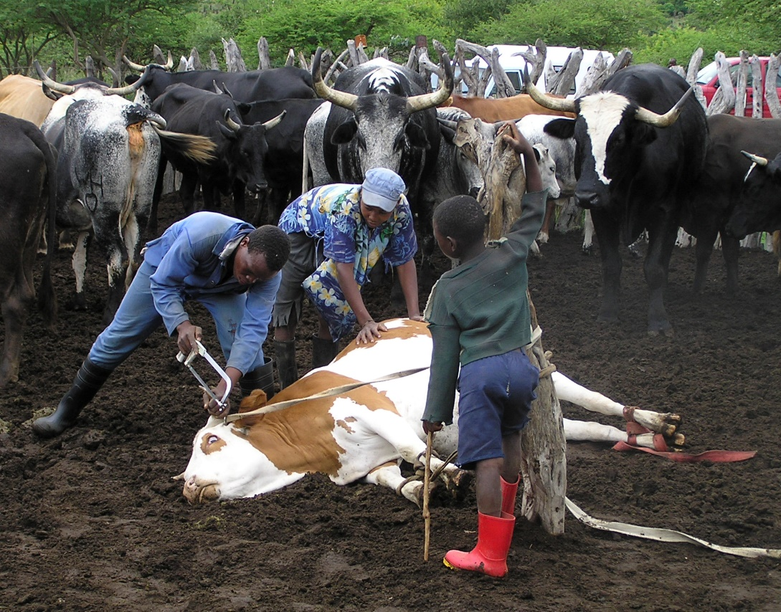
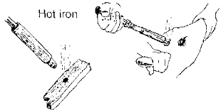
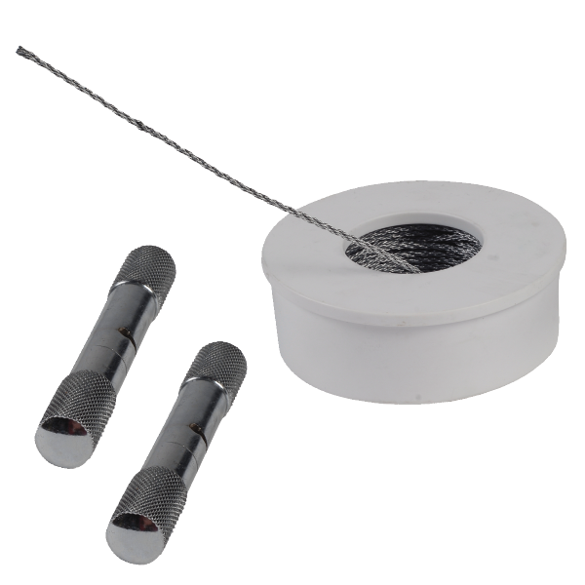
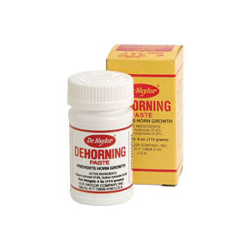
11. Dehorning
Notes:
Dehorning
What is the best age to dehorn?
What is the advantage of dehorning?
What are the different ways of dehorning?
What are the advantages and disadvantages of each type?

Slide 14
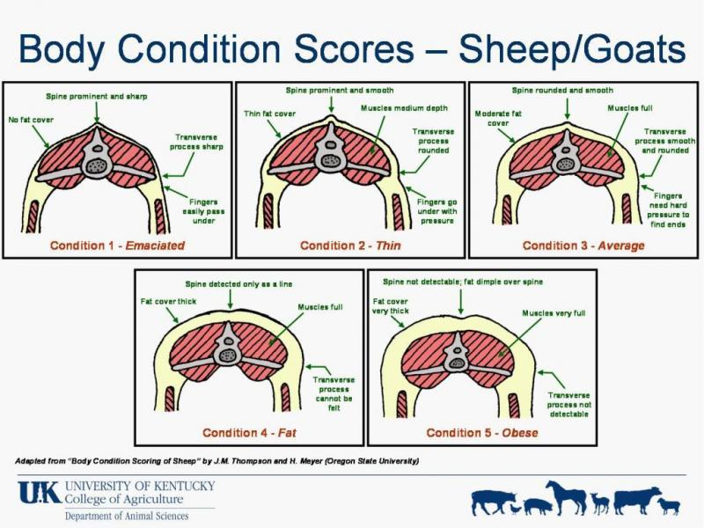
12. Condition scoring
Notes:
Condition scoring
Why is it important to condition score your animal?
What do the different scores tell you about your animal?

Slide 15
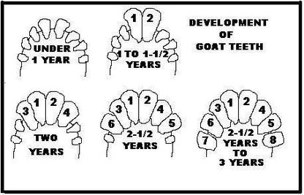
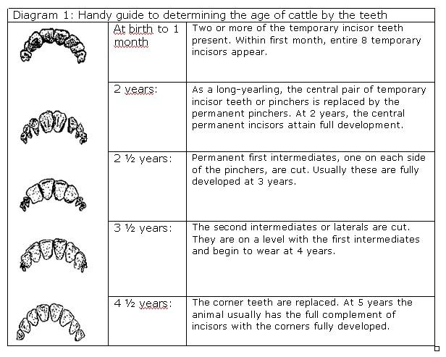
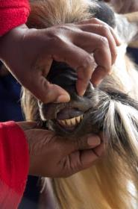
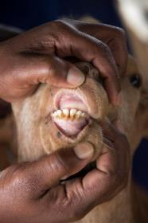
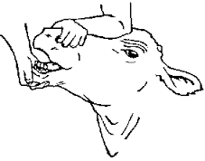
13. Checking for age
Notes:
Checking for age
Why is it important to know the age of your animal?
How do you check the age?

Slide 16
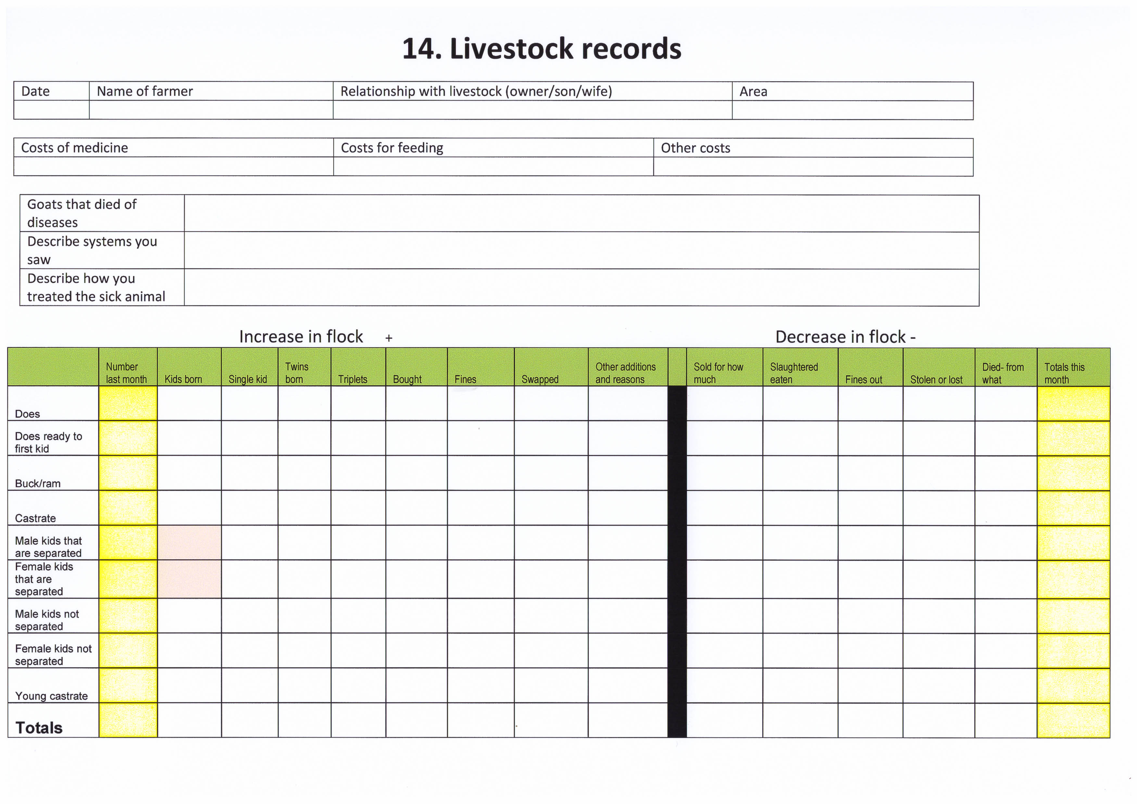
14. Livestock records
Notes:
Livestock records
This particular record is for goats but the same record is available for cattle or chickens.
What is herd composition?
Why is important to know herd composition?
Why is it important to know herd dynamics?
Why is it important to know which animals are regularly sick?
Why is it important to know our input costs?
What are the ways that your animal numbers increase or decrease?

Slide 17
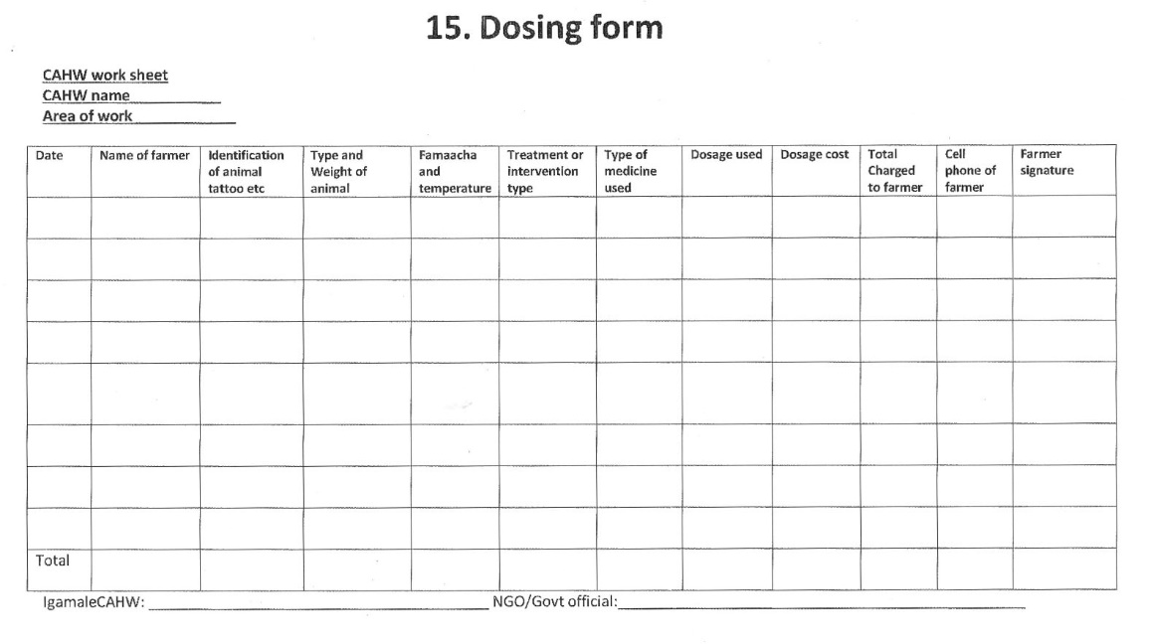
15. Dosing form
Dosing form
Notes:
Dosage form
Why is it important to understand a dosage form?
Who plays which role when completing this form?
What checks and balances can be performed by analysing this form?

Slide 18
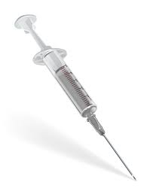
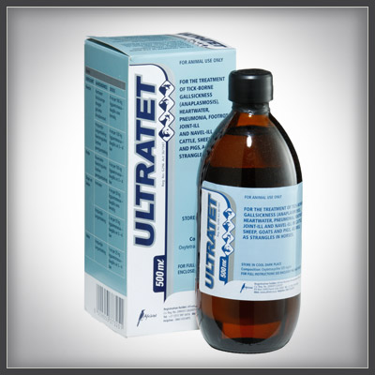
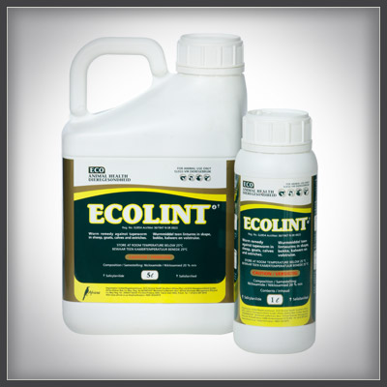
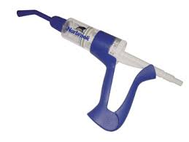
16. Dosage sums
Notes:
Dosage Sums
What system do we use to work out dosages?
What percentage do we add for wastage?
What percentage do we add for administration cost?
Are there other costs we need to add to make it worthwhile for the CAHW?
Should these costs be discussed with the client/farmer?
What do we charge if we are using the farmer’s own medicine?
What do we charge if we are using government medicine?

Slide 19
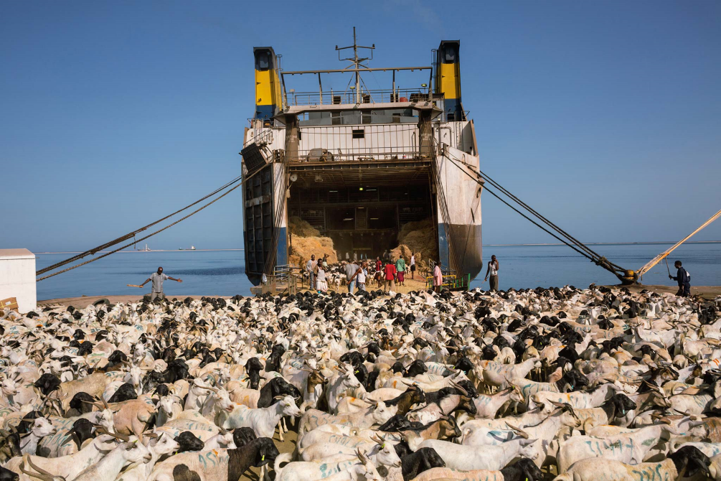
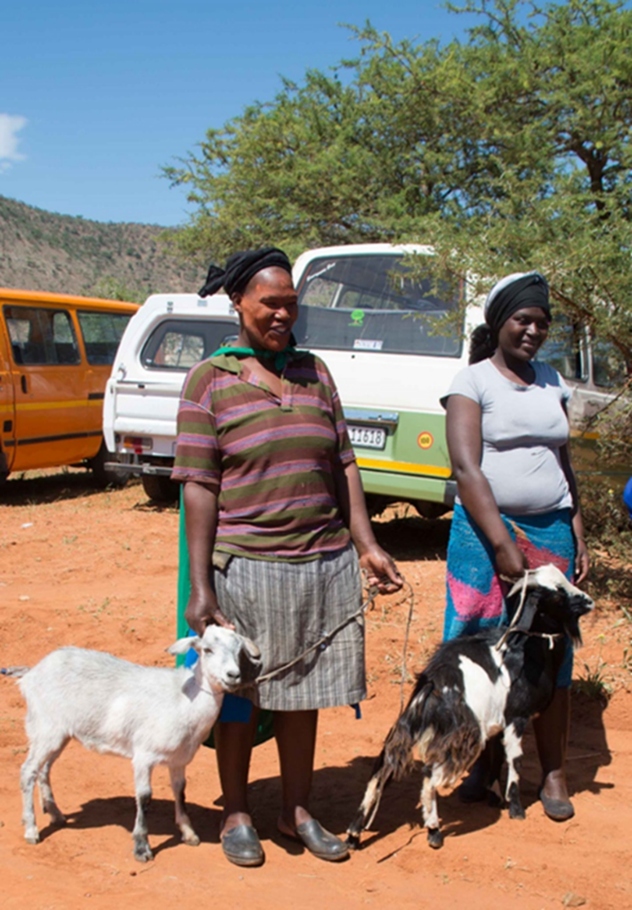
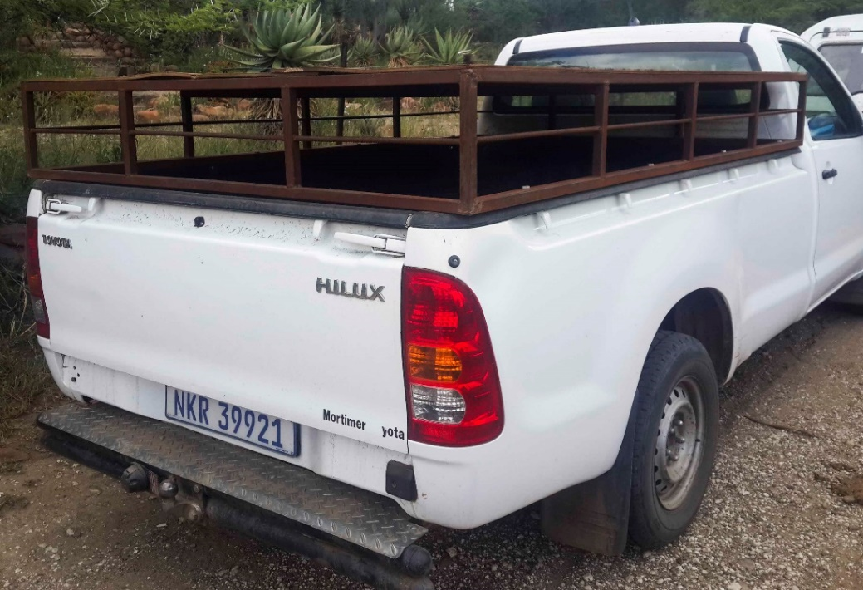
17. Marketing
Notes:
Marketing
What is herd composition?
What do you normally sell- bucks/bulls, castrates, young females, older females?
What price do you receive for each?
Is there a time of the year when your animals sell better than other times?
What colour biases are there among buyers?
What are your yearly input costs for each animal?
What are the different ways you can sell your animals?
What are the advantages and disadvantages of each?
Is it better to sell animals as groups or individuals?
What problems will you come up against if you sell livestock at markets or in big numbers?

Slide 20


18. Value adding
Notes:
Value Adding
What are the different ways to add value to your animal in your
breeding and production system?
What are the different ways to add value after slaughter?
Where have you seen these value added products being sold?
What value added products have you made and sold?

