Slide 1
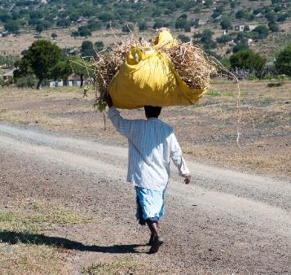
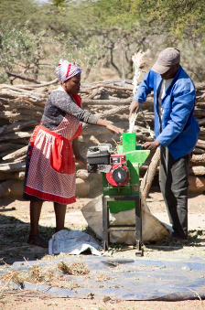
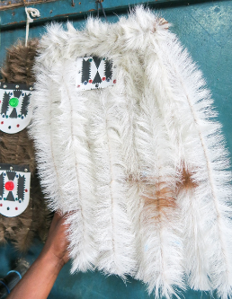
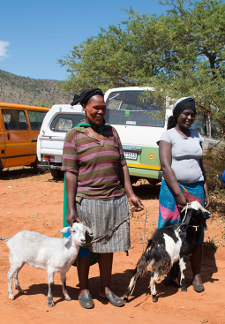
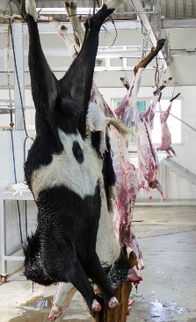
Value Adding
Microbusiness Module 3 of 3

Slide 2
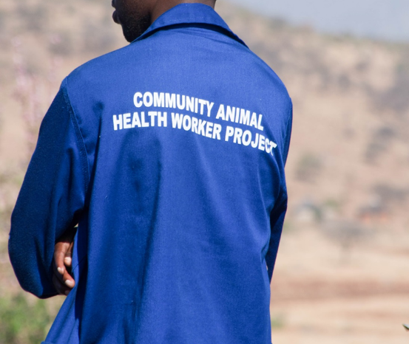
Value Adding MRDP and Heifer
References for this module are taken from MRDP Heifer document on CAHW best practice this product is available for free download from www.mdukatshani.com and www.heifer.org.za

Slide 3
Value adding options for CAHWs
Paravet
Energy blocks
Stover collection
Stover processing
Leather tanning
Crafts
Traditional attire
Auctions and sales
Cold chain
Agrihubs
Planting for winter feeds
Making feeding and production systems
Meat products

Slide 4
1.CAHW
Notes:
What is this person doing
Is he being paid for this do you think
Is his work helping people in the area
Do you have people like this in your area

Slide 5
CAHW
Concept – young people trained to help farmers by providing basic animal health support to increase herd productivity in exchange for payment. A vet kit given as a start up grant.
Examples – at every dip tank there are young people who help with livestock

Slide 6
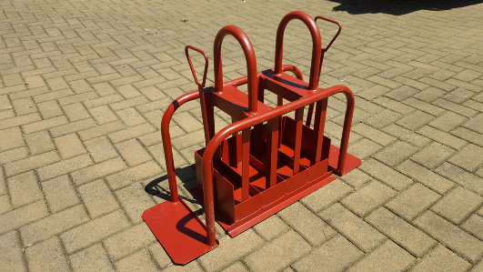
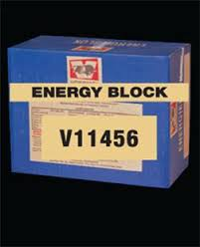
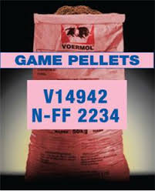
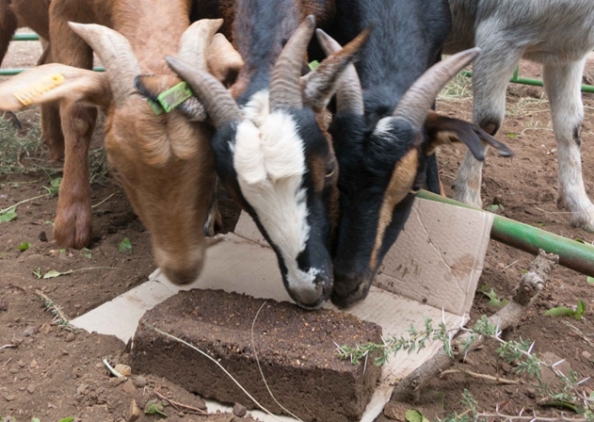
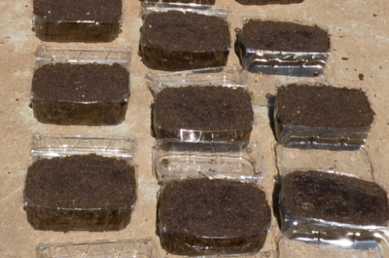
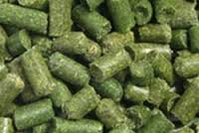
2. Energy Blocks
Notes:
Have you seen products on the left for goats
What do they do for goats
What do you think the difficulties are with them (pricing, size, availability)
The products on the right have you seen them and how are they made and what have you done with them

Slide 7
Blocks
Concept – mix own blocks of relevant sizing and local availability and palatable pricing to sell to farmers to improve productivity
Examples – making with brick maker or plastic mould selling at R10 each generating minimum R300 profit per mix

Slide 8
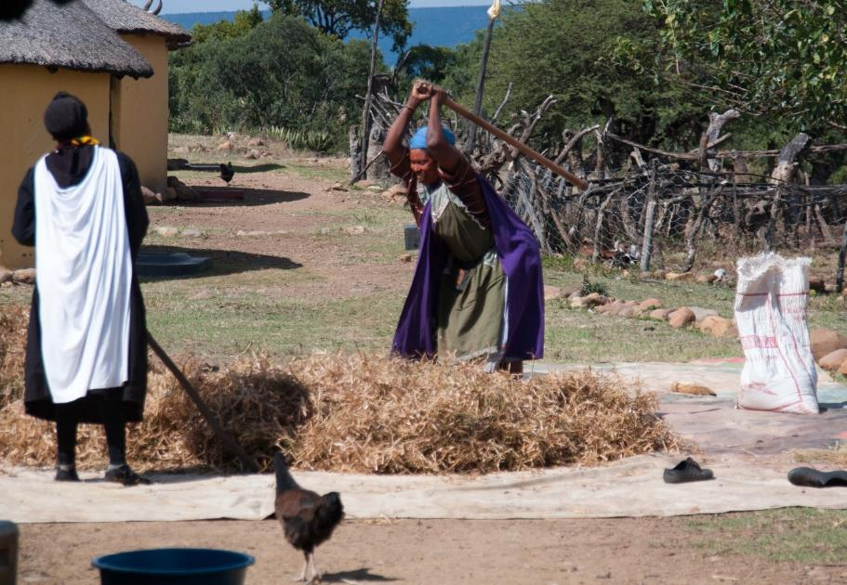
3. Stover collection
Notes:
Ask audience if they recognise this –What is happening?
Do they see this at home?
What happens to the stover at home area?
Is this stover worth anything currently?

Slide 9
Stover collection
Concept – CAHW collect stover from farmers in their area and store it appropriately then process it in winter and sell it as animal feed.

Slide 10
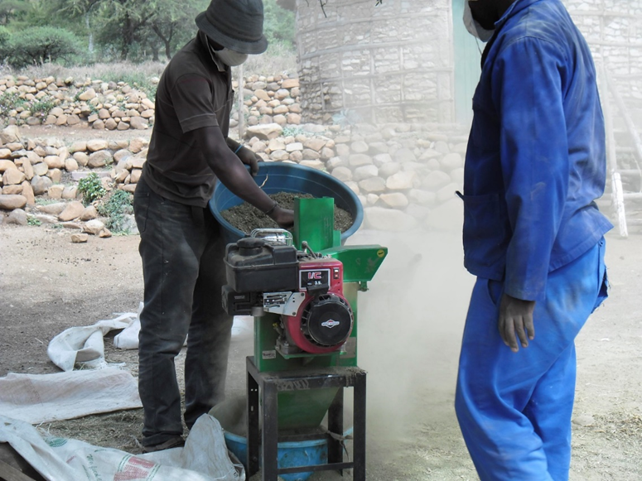
4. Stover processing

Slide 11
Stover processing
Concept – CAHW have a hammer mill that they charge farmers to process their stored stover.

Slide 12
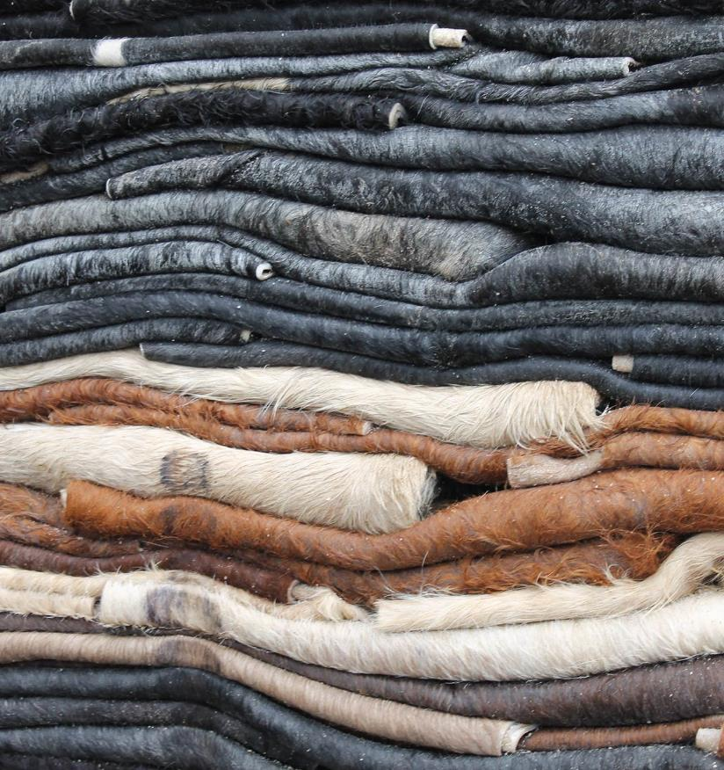
5. Leather tanning
Notes:
What do people do with skins in your area
Do they get value out of them
If they were tanned would they be more valueable

Slide 13
Leather tanning
Concept – CAHW buy skins from farmers and through processing them into tanned leather products create value and make a profit

Slide 14
6. Crafts
Notes:
Do you have any leather products
Could any of these be made with local products
Are there any things made from leather you think could be sold as new ideas

Slide 15
Crafts
Concept –locally made products using local and unique skills and designs for tourist industry or passing trade

Slide 16
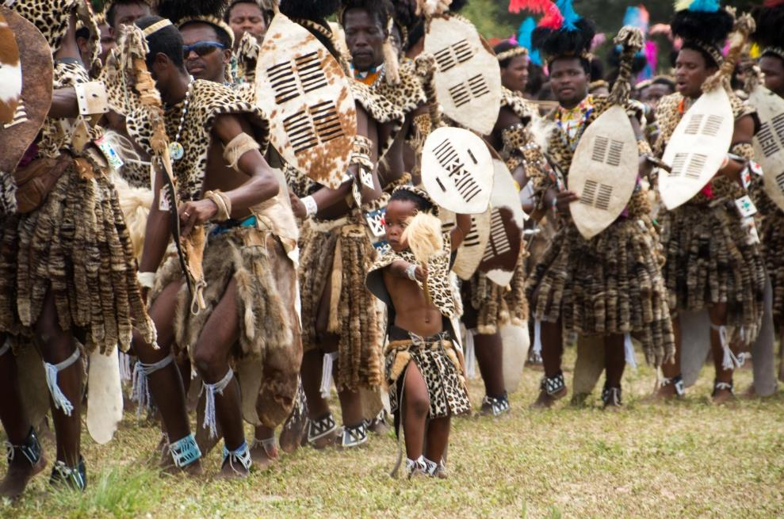
7. Traditional attire
Notes:
Do you recognise these products
Do any of you family own any of them
Are they cheap or easy to acquire

Slide 17
Traditional attire
Concept- There is a growing pride in traditional roots and traditionalist churches. This has grown the market for high value high cost products sold to local people in KZN

Slide 18
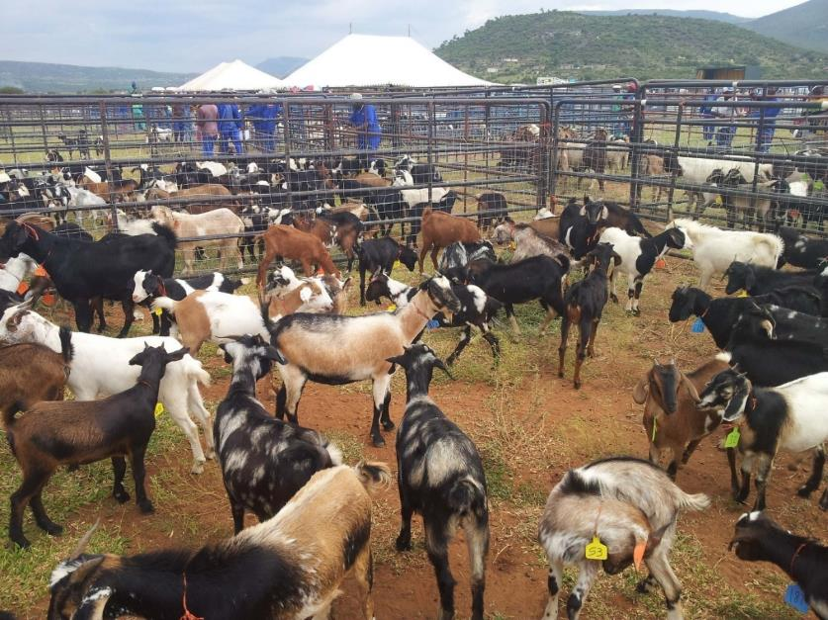
8. Auctions and sales
Notes:
How are goats sold in your area
Do you ever see or hear of formal sales
Is this current sales system sufficient
Are there problems with current sales system
What do you think could be done
What are the possible dangers of these bigger better sales systems

Slide 19
Auctions and sales
Concept – the sales of goats gets optimised through regular rural sales with oversite and supervision by police and livestock associations. Large public auctions bi-annualy changes farmers and public opinions about sales systems

Slide 20
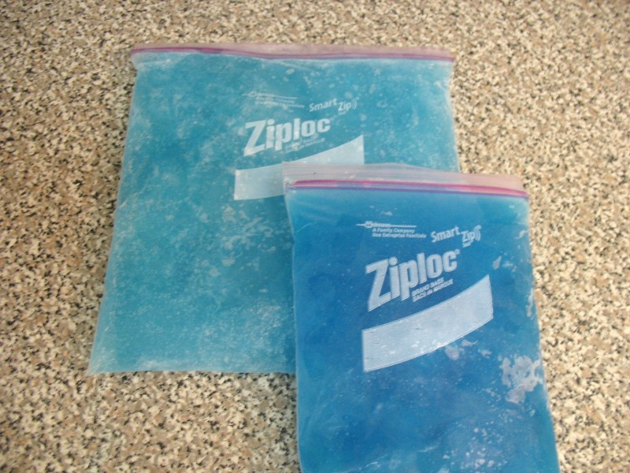
9. Cold chains
Notes:
What are these
Do you have them available locally where you from
Would they help

Slide 21
Cold chains
Concept – the lack of cold chains in rural villages hinder farmers ability to treat their livestock. A CAHW would be supported in having cold chain support equipment so they could use this to store and sell vet supplies.

Slide 22
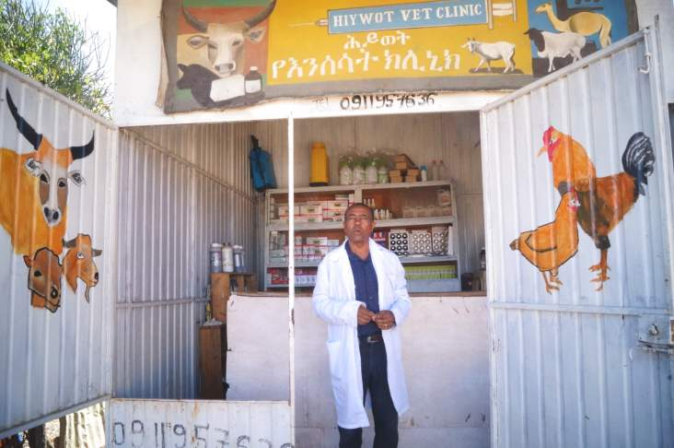
10. Agrihubs
Notes:
Are there shops that sell and buy agricultural produce in your area
Are they supported by local farmers
Are there changes needed in there models or systems

Slide 23
Agrihubs
Concept- a co operative type market – owned and managed by a collective of farmers to both sell agricultural related products and buy to sell on products from farmers in the group. There may a pricing system that makes it worth being a member of the owning body

Slide 24
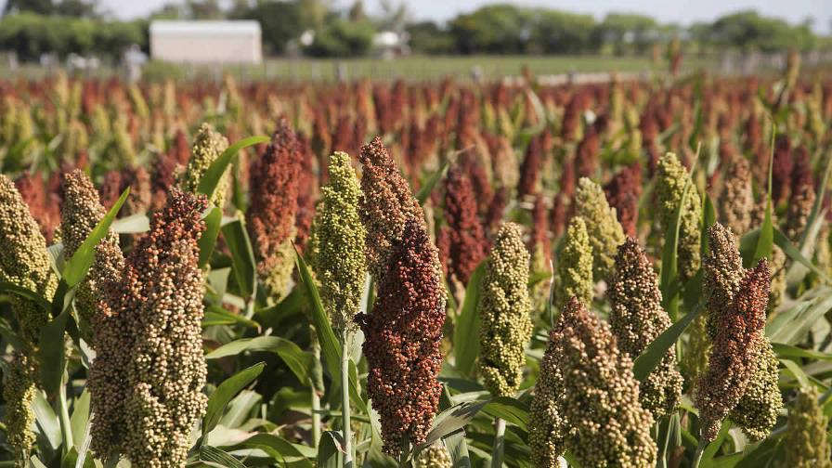
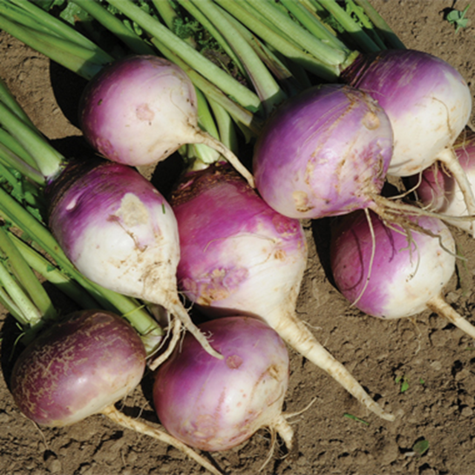
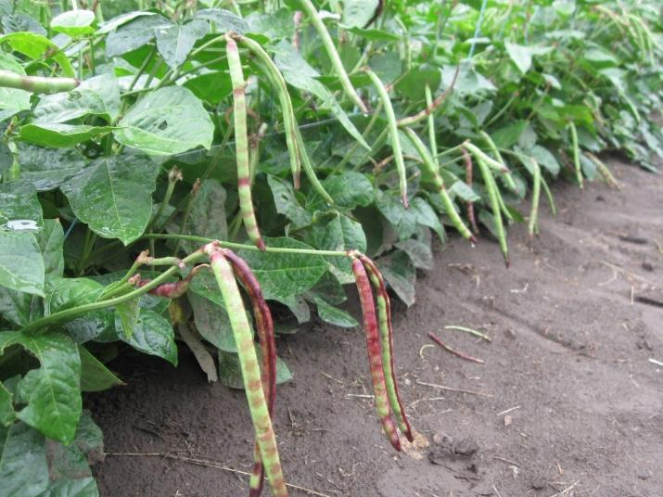
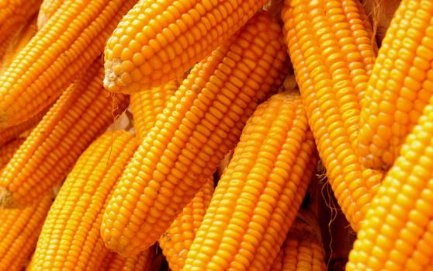
11. Planting winter feeds
Notes:
Have you seen these before
Do you have garden or farming areas in your home area protected from livestock
Do farmers currently plant foods to feed the livestock

Slide 25
Planting winter feed
Concept –CAHW get a plot or field in the local growing area and plant food specially for feeding to livestock in the winter often with some processing involved

Slide 26
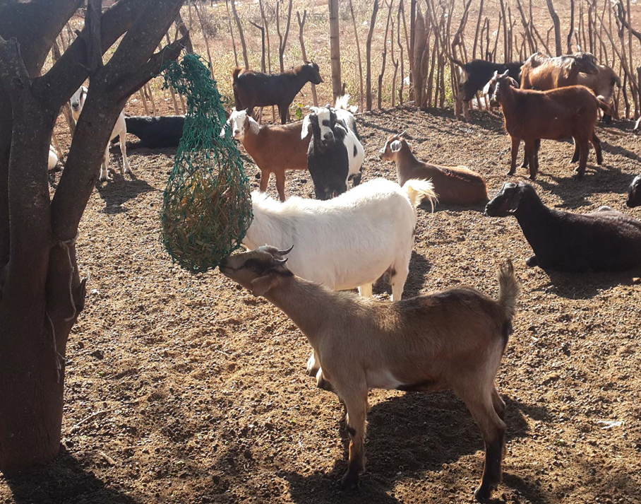
12. Making feeding and production systems
Notes:
How do you feed goats in your area
Is it a useful system
Does it cause a waste of food

Slide 27
Making feeding and production systems
Concept –CAHW make and sell items like feeding systems or restraining systems to farmers with animals and create a small business from this
Chicken nests sold at pension days – nets for feeding

Slide 28
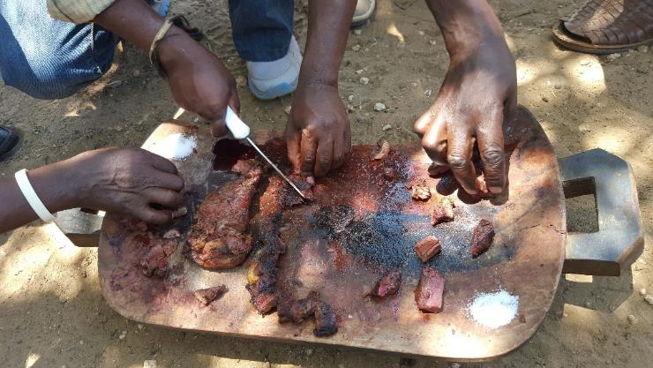
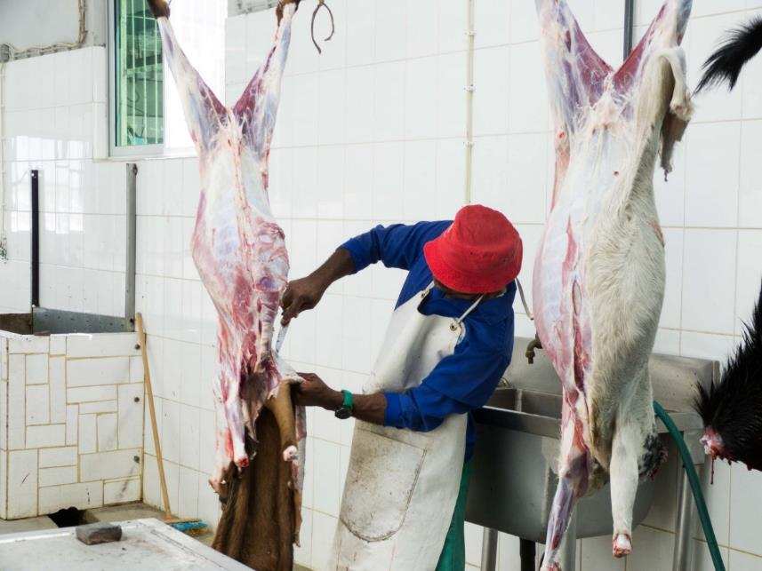
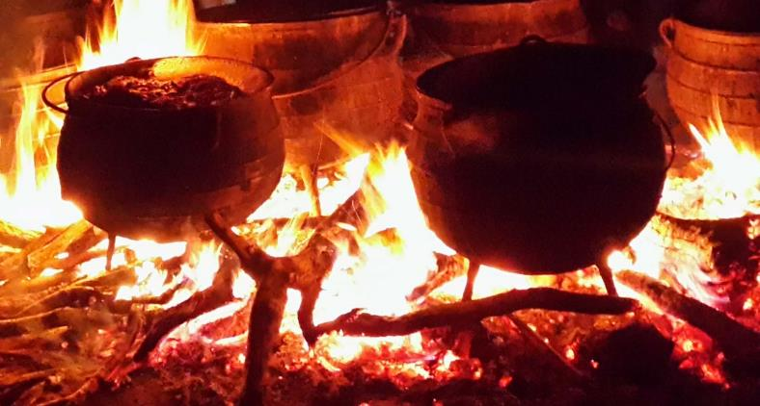
13. Meat products
Notes:
Is there anyone here who has never eaten goat
How is goat cooked and eaten in your area
Have you ever seen goat meat sold
Would you buy it

Slide 29
Meat products
Concept – meat processing is started while campaigns to change perceptions with the public to appreciate the possibilities there are in goat dishes. Consider goat meat production for urban areas which have a much bigger central African population.

